Slide 1
COMP 4801 - Final Year Project Final Presentation
Group: fyp23029
Member: Ng Tsz Hei (3035780192)
Project Title: All-in-one mobile application for elderly
Supervisor: Professor Wu, Chuan

Slide 2
Outline
Background
Motivation
Design and Methodology
Results and Discussions
Limitations, possible improvements & future direction
Conclusion

Slide 3
Background
From July 2022 to July 2023:
- Number of telephone deception cases rises from
170 to 292 (71.8%)
- Monetary Loss rises from 65.65m to 94.2m (43.5%) [1]
- Situation worsening
According to Hong Kong Police Force, 494 out of 1150 victims (43%) are elderly in 2020 [2]
- Elderly accounts for a significant portion
Necessary to help them prevent telephone deception
Figure 1 Year-to-year Comparison in Telephone Deception in Hong Kong (July) [1]

Slide 4
Motivation
Problems except telephone deception:
- Elderly missing
- Accidents (e.g. fainting/falling)
- Generation gap
Problems of Existing applications:
- Not specially designed for elderly
- Elderly hard to manage many apps
An all-in-one mobile application for elderly is a good solution
Application name: Elder Link

Slide 5
Design (5 Main Features)
1) Deceptive Calls Detection
Scan incoming calls and compare to a list of suspicious phone number
2) Location Tracking
Constantly keep track on elderly's location and assist searching in case of missing
3) Body status monitoring
Connect to smartwatch and monitor the body status of elderly
4) Fall Detection
Use built in accelorometer of the phone to track the phone acceleration and detect falling
5) LLM integration
Integration LLM as a chatbot to assist problem solving

Slide 6
Methodology
System Modelling:
Lucidchart for UML diagrams (system architecture) and ER diagrams (database design)
User Interface Design:
Figma (interactive & convertable to code)
Front end:
React Native (cross platform & support Android and IOS phones)
Backend:
Google Firebase (good security & easy setup)
Version Control:
Github (project management features)

Slide 7
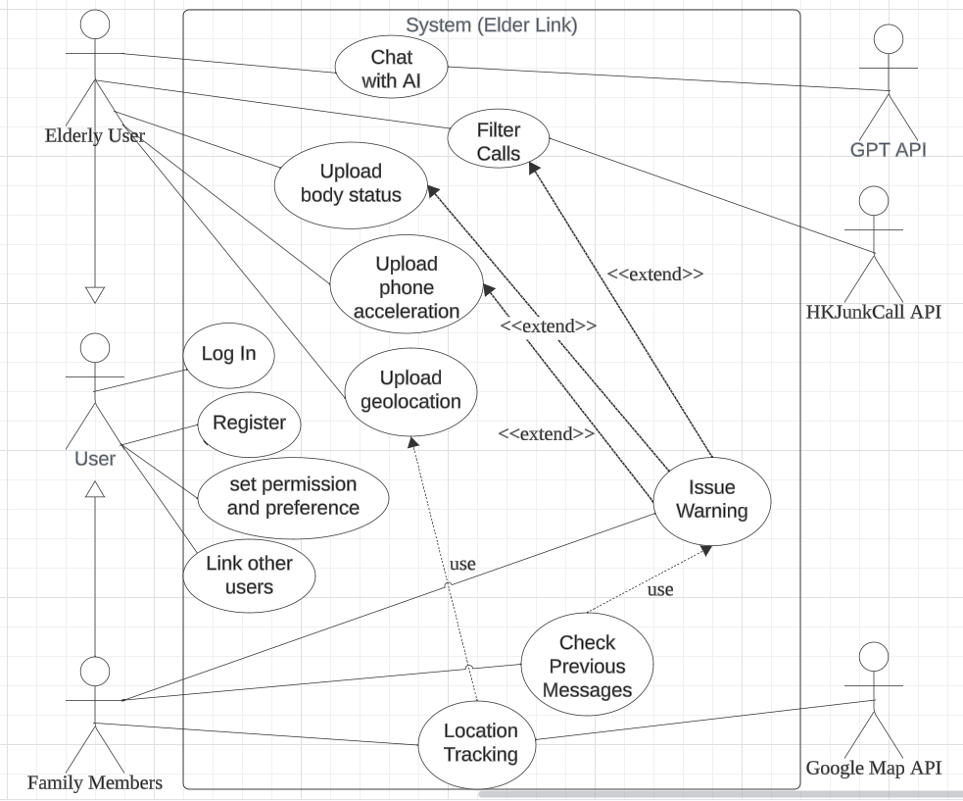
System Design
2 types of targeted users – elderly and family members
All users:
- Log in
- Register
- Set permission & preference
- Link other users
Figure 2 Use Case Diagram of Elder Link

Slide 8
System Design
Elderly users:
- chat with AI (call GPT API)
- Filter incoming calls (call HKJunkCall API)
- Track body status/phone acceleration/geolocation in background
- Occasionally issue warning in case suspicious call/falling/dangerous body status
Figure 2 Use Case Diagram of Elder Link

Slide 9
System Design
Linked family users:
- Track location uploaded by elderly users (call Google Map API)
- Receive warning
- Check previous messages(warning) issued
Figure 2 Use Case Diagram of Elder Link

Slide 10
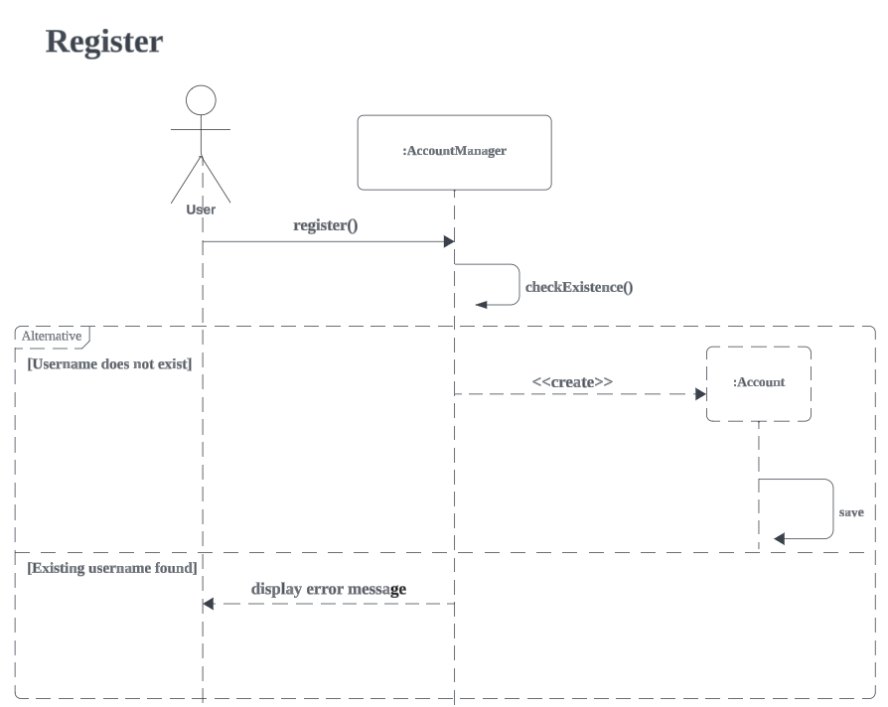
System Design
User send username, password, display name
Account Manager checks if username exists in database
If no duplicated username, Account Manager creates account object and save in database
If duplicated, display error message
Figure 3 Sequence Diagram for register

Slide 11
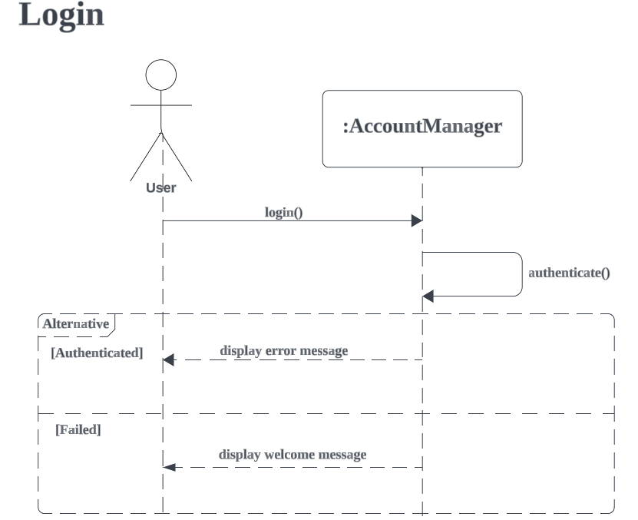
System Design
User logins with username, password
Account Manager checks database record and authenticates
If success, send welcome message and navigate to main page
If fail, send error message
Figure 4 Sequence Diagram for login

Slide 12
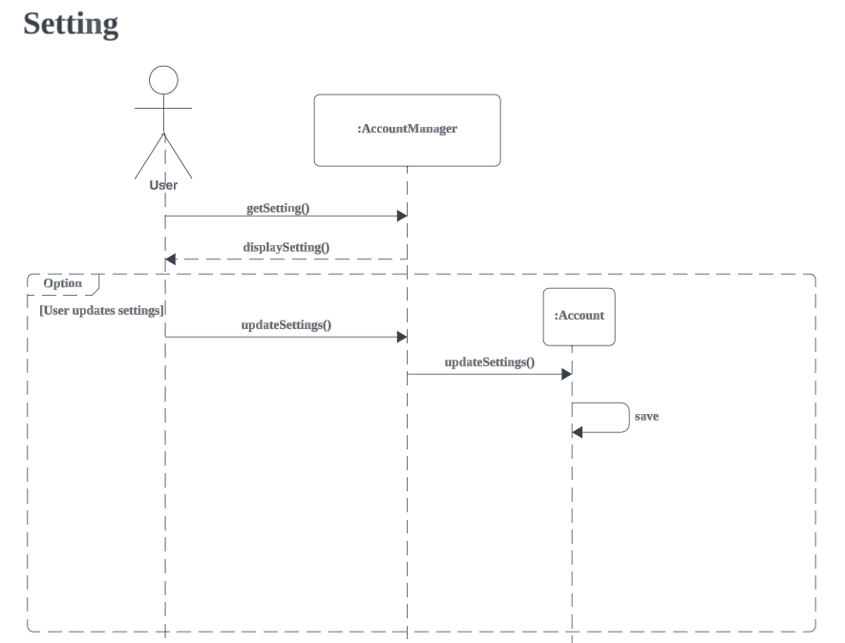
System Design
User retrieves up-to-date settings and settings displayed
If user chooses to update, AccountManager updates account object
Save updated account object to database
Figure 5 Sequence Diagram for setting

Slide 13
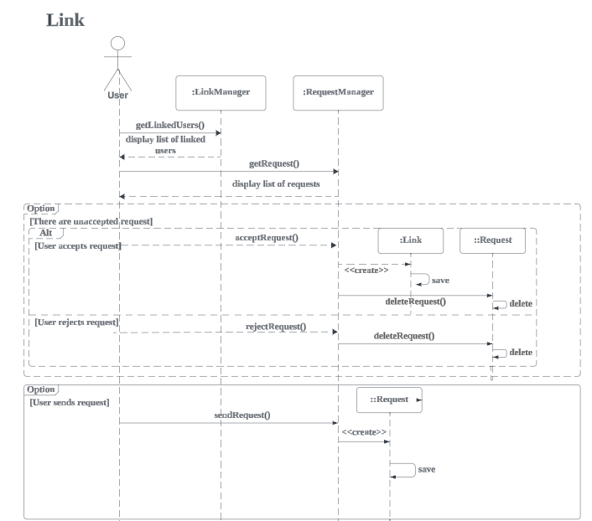
System Design
User gets linked users list and requests
If user accepts, create link and save to database. Then delete request anyway.
If user sends a request, create request object and store in database.
Figure 6 Sequence Diagram for link

Slide 14
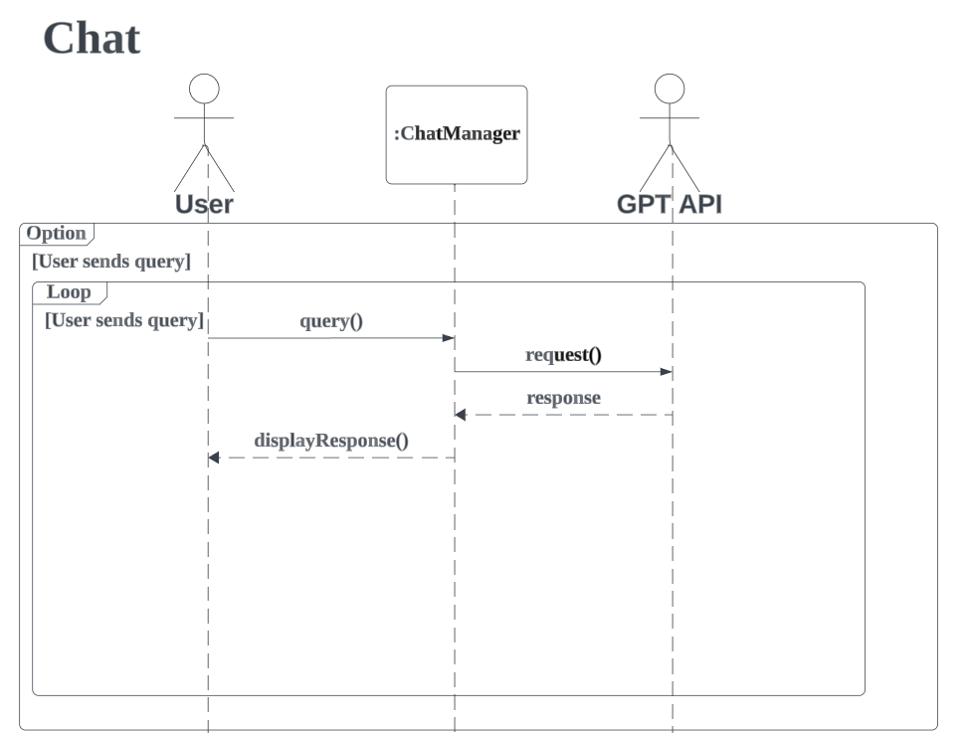
System Design
If user sends query, ChatManager sends request to GPT API.
ChatManager receives response from GPT API and display to user.
Figure 7 Sequence Diagram for chat

Slide 15
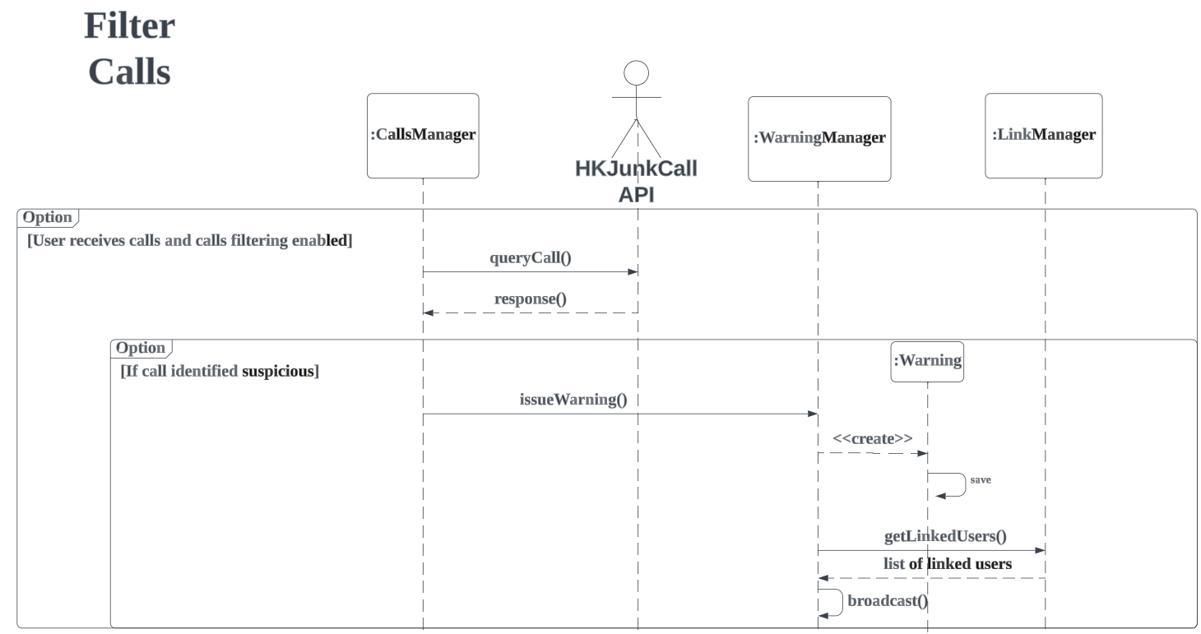
System Design
If user receives call, CallsManager query phone number with HKJunkCall API.
If identified suspicious, call WarningManager with warning string.
WarningManager create Warning object, save it in database, then get list of linked users and broadcast message
Figure 8 Sequence Diagram for filter calls

Slide 16
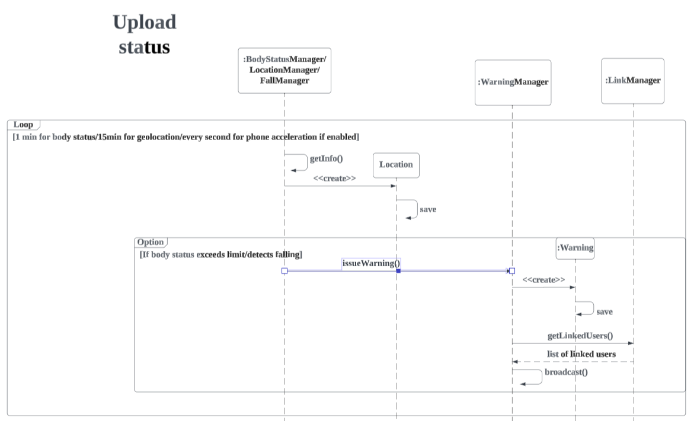
System Design
For every 1min/15min/1second, BodyStatus/Location/FallManager retrieve respective data.
Location Manager creates Location object and store in database.
If body status exceeds limit/fall detected, issues and broadcast warning like before
Figure 9 Sequence Diagram for upload status

Slide 17
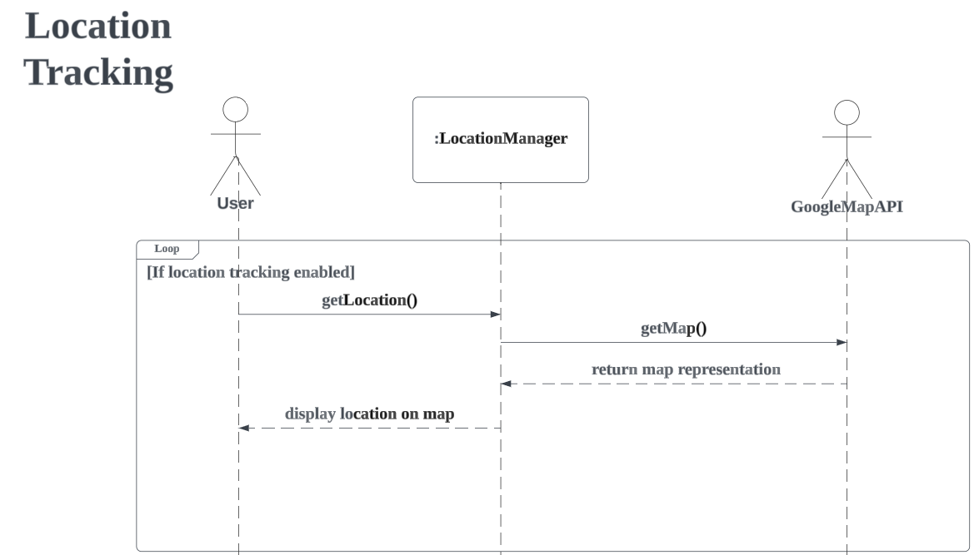
System Design
If users enabled location tracking, get location from LocationManager
LocationManager then read info in database and call Google Map API to get map representation
Location with map is displayed to users
Figure 10 Sequence Diagram for location tracking

Slide 18
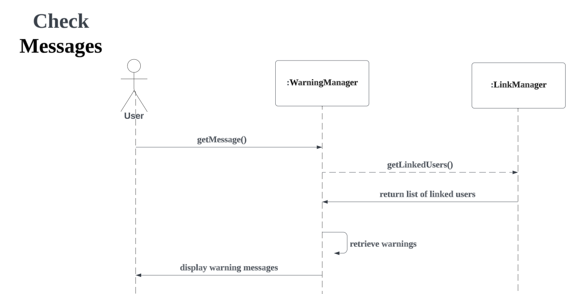
System Design
User calls to get previous warning messages from WarningManager
WarningManager gets a list of linked users from LinkManager and retrieve warning messages in database
WarningManager displays warning messages to users
Figure 11 Sequence Diagram for check message

Slide 19
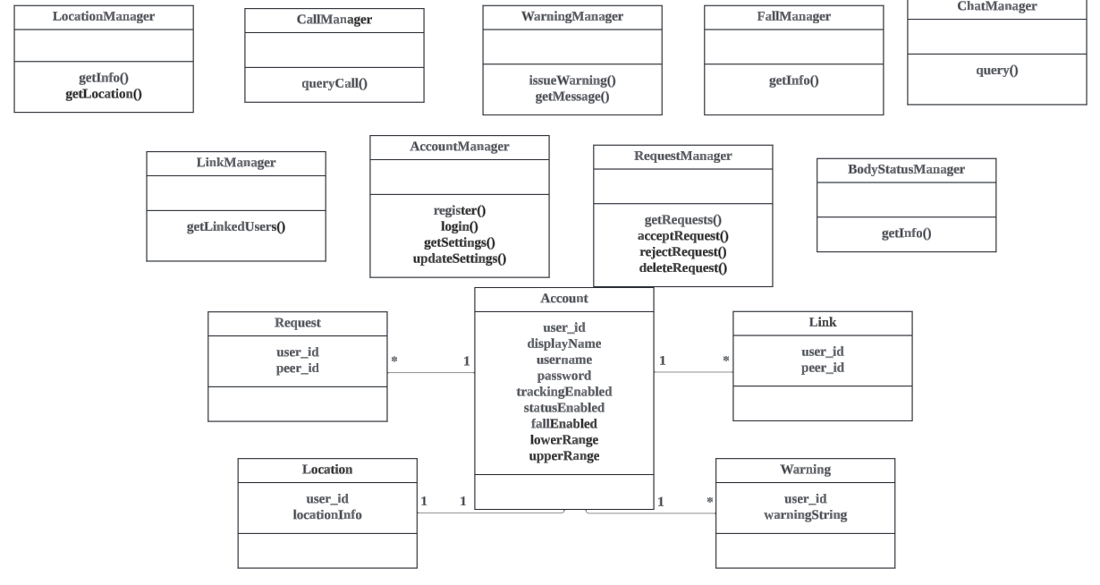
System Design
- Managers
- Account, Link, Request, Location, Warning classes
Figure 12 Class Diagram of the Application

Slide 20
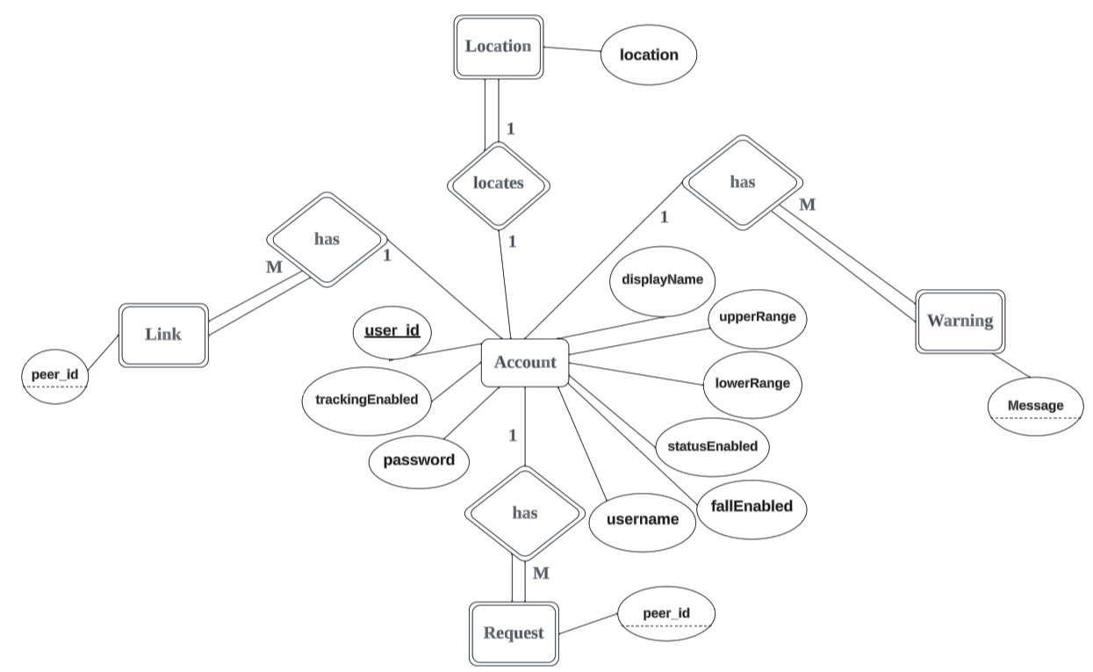
Database Design
Account entity
Attributes:
User id / username / password / trackEnabled / statusEnabled / fallEnabled / lowerRange / upperRange
Relationship:
Location (1 to 1)
Warning (1 to many)
Link (1 to many)
Request (1 to many)
All partial participation
Figure 13 Entity Relationship Diagram of the Application

Slide 21
Database Design
Link entity (weak entity)
Attributes:
Peer_id
Relationship:
Account (many to 1)
Total participation
Foreign key: user_id referencing Account
Figure 13 Entity Relationship Diagram of the Application

Slide 22
Database Design
Location entity (weak entity)
Attributes:
location
Relationship:
Account (1 to 1)
Total participation
Foreign key: user_id referencing Account
Figure 13 Entity Relationship Diagram of the Application

Slide 23
Database Design
Warning entity (weak entity)
Attributes:
Message
Relationship:
Account (many to 1)
Total participation
Foreign key: user_id referencing Account
Figure 13 Entity Relationship Diagram of the Application

Slide 24
Database Design
Request entity (weak entity)
Attributes:
Peer_id
Relationship:
Account (many to 1)
Total participation
Foreign key: user_id from Account
Figure 13 Entity Relationship Diagram of the Application

Slide 25
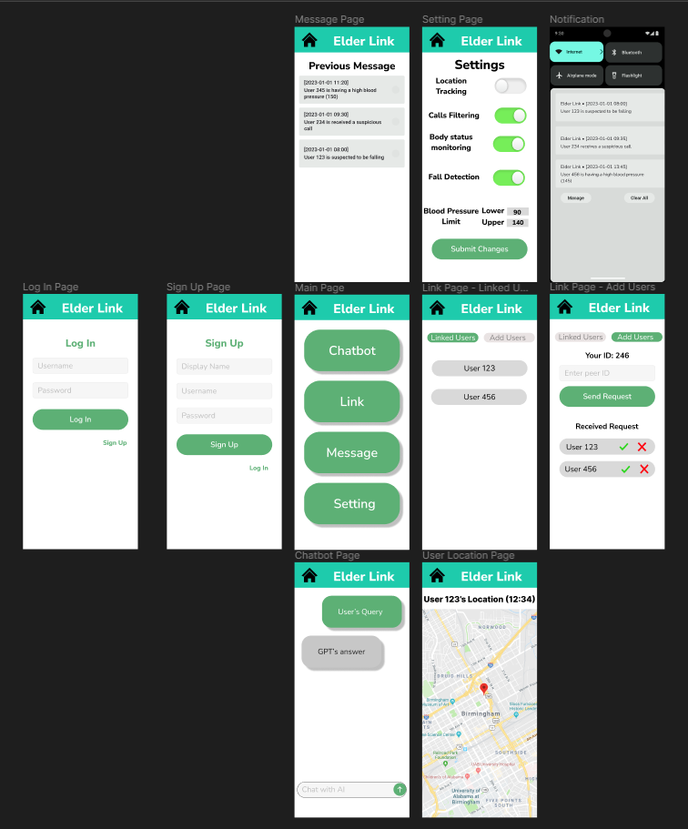
User Interface - Prototype
Figure 15 Figma UI Prototype

Slide 26
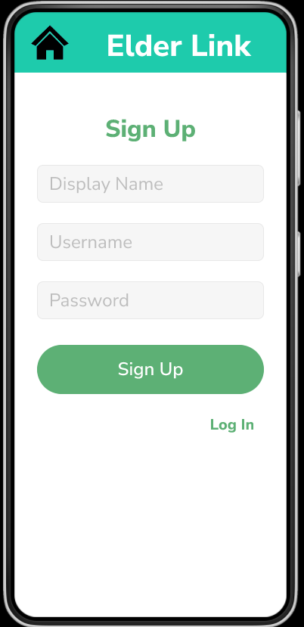
User Interface - (Login & Signup)
Figure 16, 17 Login and Signup Pages

Slide 27
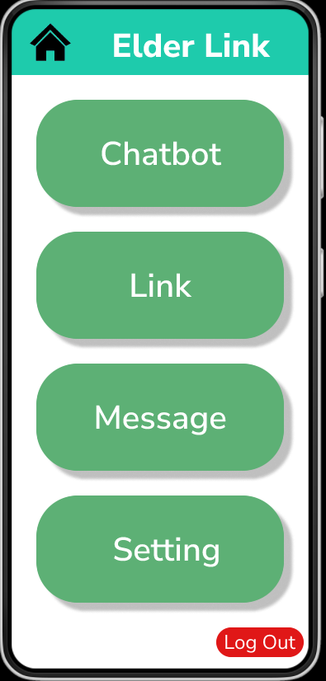
User Interface - Main Page
Navigation to :
- Chatbot
- Link
- Message
- Setting
Log out button
Figure 18 Main Page

Slide 28
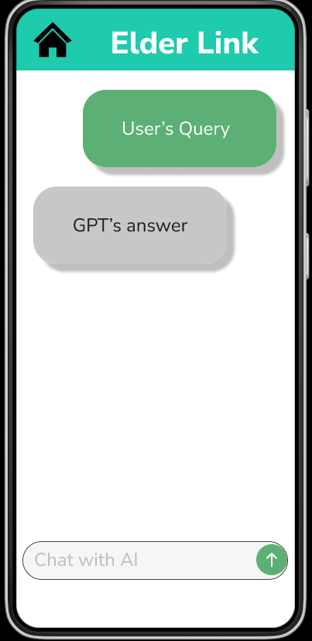
User Interface - Chatbot Page
Figure 19 Chatbot Page

Slide 29
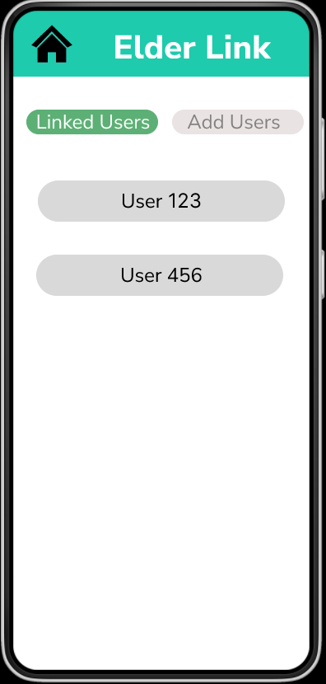
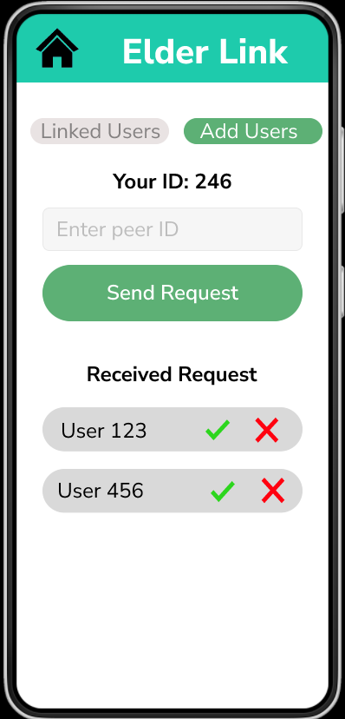
User Interface - Link Page
Figure 20-22 Linked users, user location, add users pages

Slide 30
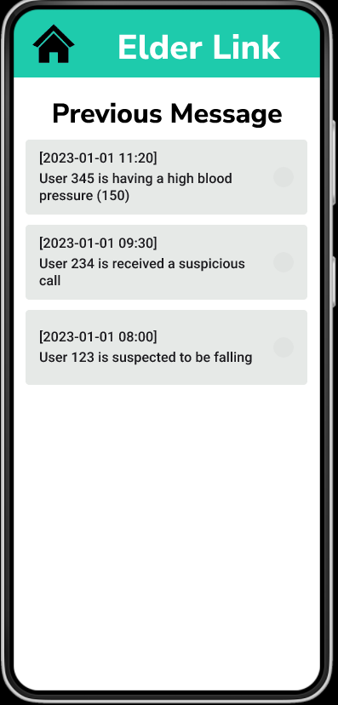
User Interface - Message Page
- Display previous warning messages
Figure 23 Messages Page

Slide 31
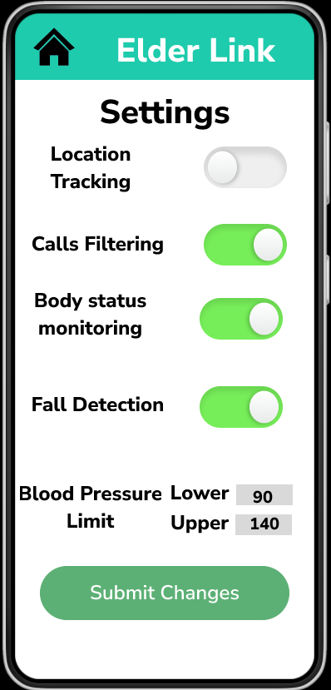
User Interface - Setting Page
Toggle button to enable / disable functions
Text boxes to enter upper/lower blood pressure limits
Submit button to save changes
Figure 24 Setting Page

Slide 32
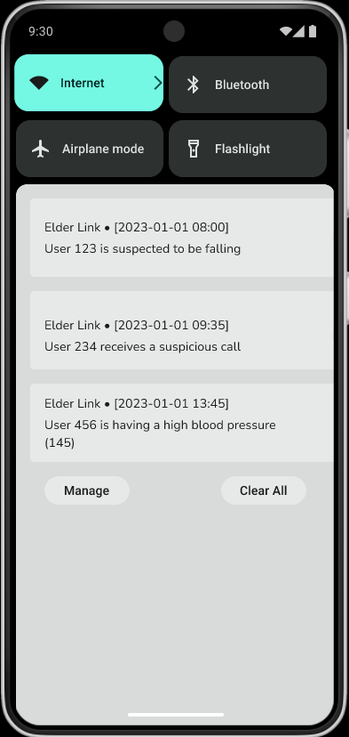
User Interface - Warning Notification
Sample notification if linked users trigger warning
Figure 25 Warning Notification

Slide 33
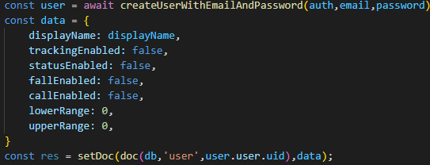
Implementation – Authentication & database
Firebase cloud service used for authentication and database
Procedures to enable firebase authentication service:
Initialize an app instance with the necessary credentials (apikey, project ID…)
Initialize an authentication instance with app instance
User createUserWithEmailAndPassword and signInWithEmailAndPassword to create and authenticate account, given email and password
Procedures to enable firebase database service:
Initialize database instance with app instance
Use getDoc and setDoc method to read and write database
NoSQL database, stores key, value pairs

Slide 34
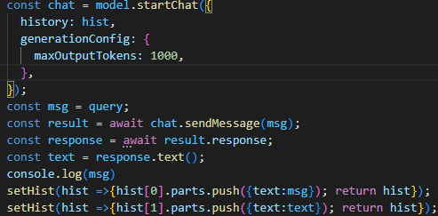
Implementation – LLM integration
LLM model chosen: Google Gemini
Procedures to enable Gemini model:
Create a GoogleGenerativeAI instance with a registered API key
Create a model instance of desired model
To use multi-turn conversations (chat) mode:
Track chat history
Provide chat history together with generation configuration when initialize chat instance
Call sendMessage method of chat and retrieve response

Slide 35
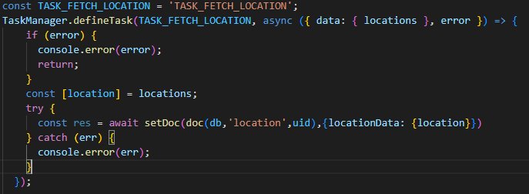
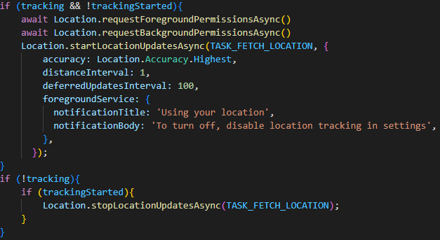
Implementation - Location Tracking
Define a task and a callback in TaskManager of React Native
Ask for permission of location tracking
Use startLocationUpdatesAsync method from ‘expo-location’ library, can configure accuracy, min distance/time interval for update
Bind the method to the TaskManager so that the callback is executed after retrieving the data (uploading the location data to database)

Slide 36
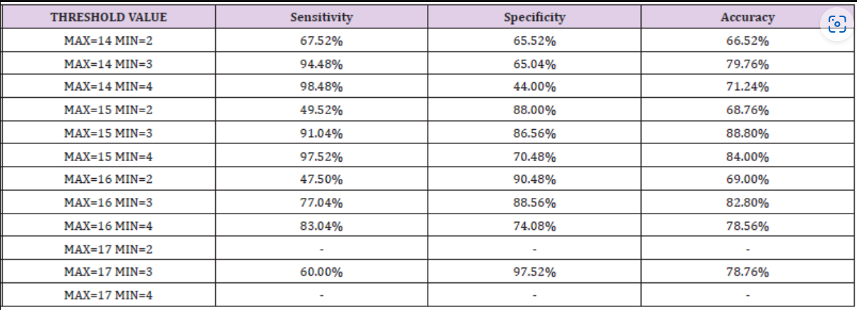
Implementation – Fall Detection
Algorithm used:
Reference from research article Multi-Sensor Fall Detection for Smartphones
Given accelerometer reading Ax, Ay, Az, calculate signal magnitude vector, which is square root of their sum of square
Threshold value chosen for triggering fall detection: MAX=15g MIN=3g
Good balance of sensitivity (~91%), specificity (~86%), and accuracy (~88%) [3]

Slide 37
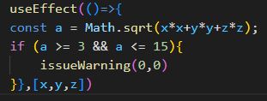
Implementation – Fall Detection
Accelerometer class used from ‘expo-sensor’ library
First ask permission, then set a time interval for tracking, finally attach to a listener
When x,y,z values change, call back in useEffect will be called, which apply the formula and issue warning if signal magnitude vector value falls outside the predefined interval

Slide 38
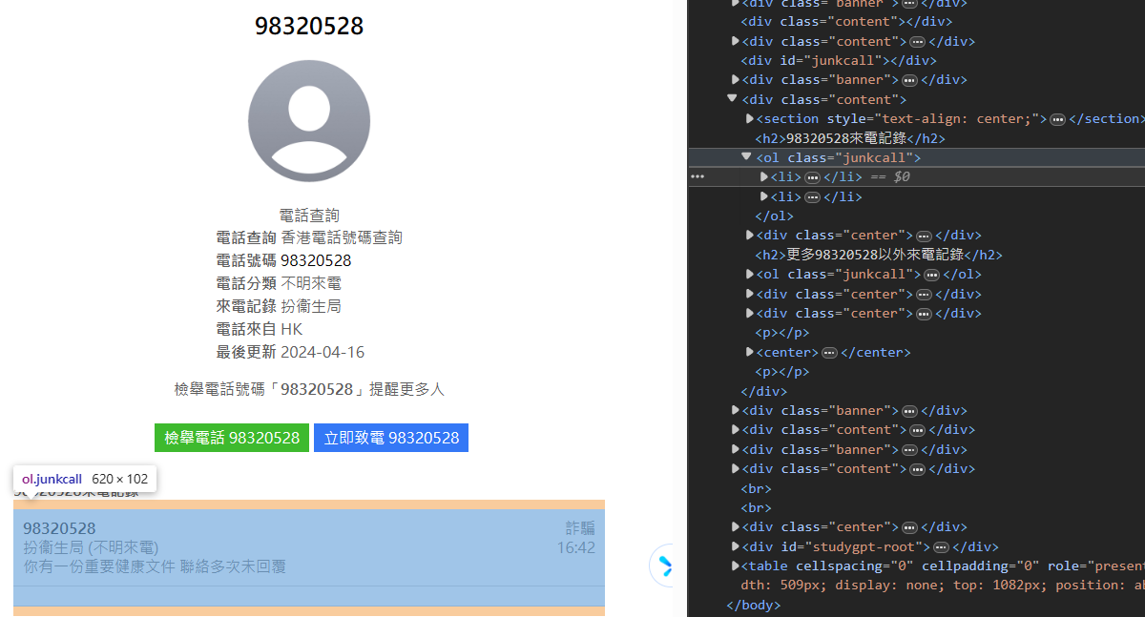
Implementation – Deceptive Call Detection
Web scraping from JunkCall HK, a database that stores suspicious phone number list
The targeted information – whether the call has been reported deceptive or not, lies in a HTML ordered list element with class name “junkcall”

Slide 39
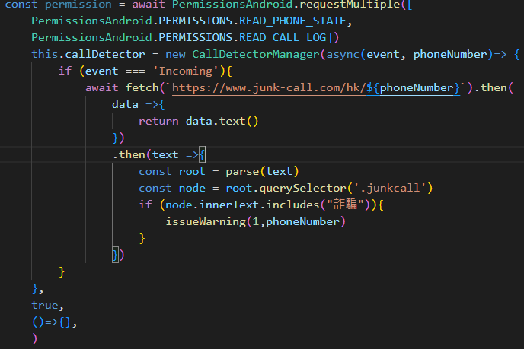
Implementation – Deceptive Call Detection
Ask for required permission from user
Use CallDetectorManager Class from ‘react-native-call-detection’ library to get phone number of incoming call
Append the phone number in URL and use javascript’s fetch API to fetch from JunkCall HK
Parse result to Document Object Model element, get element with class name “junkcall”, and check if the inner text contains the keyword “deception” in Chinese

Slide 40
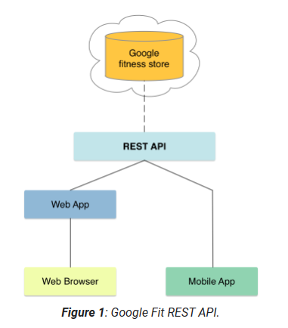
Implementation – Body Status Monitoring
To retrieve health data from users:
Method 1: develop wearOS application for different smartwatch brands and connect to our application
Method 2: retrieve data from a third-party application that supports different smartwatch
Google Fit is a popular health application that can be used for different smartwatches and Google provides API to retrieve health data

Slide 41
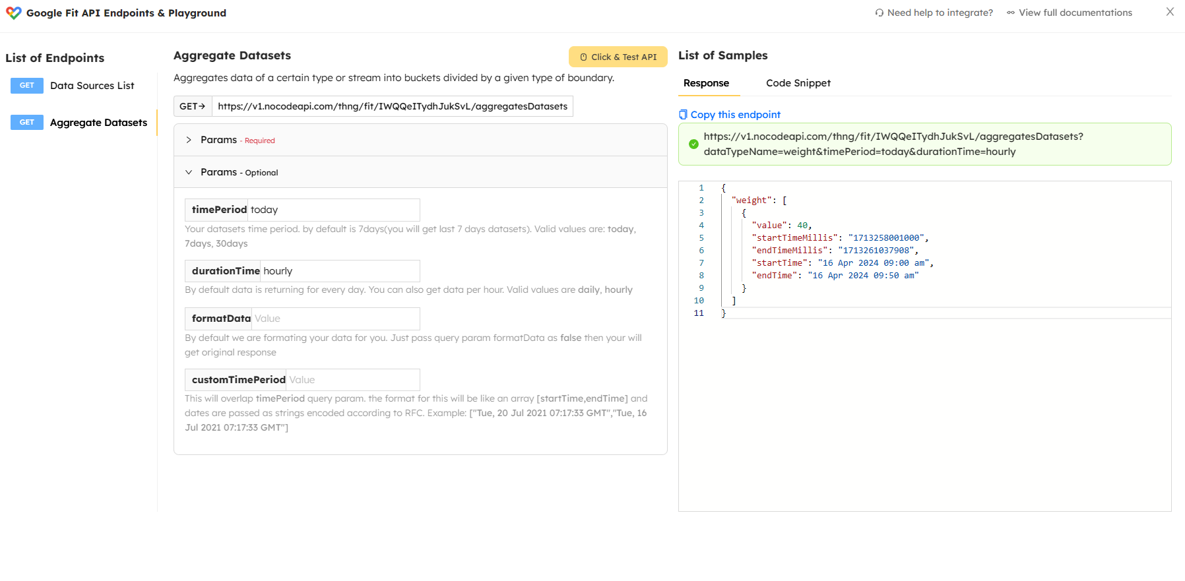
Implementation – Body Status Monitoring
Attempted to use the suggested “react-native-google-fit” library, yet version/env conflict and cannot build the app
Temporary alternative: NoCodeAPI
Provides a REST API and allows data to be fetched directly by a get request to the URL.
Requires user to register the service in NoCodeAPI and provide the URL
Then get body data from URL, compare with predefined limit and determine if warning should be issued

Slide 42
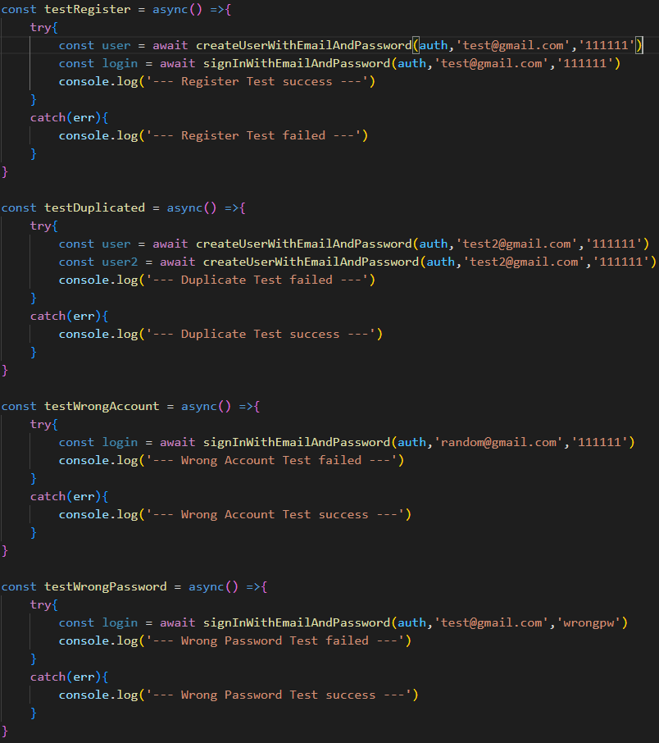
Testing - Authentication
Test cases on authentication:
Normal register and sign in
Duplicated registration
Wrong account
Wrong password

Slide 43
Testing - settings
Body status data limit entered by users
Has to prevent invalid input that causes bugs
Test cases that should fail:
Not a number
Negative value
Lower bound larger than upper bound
Test cases that should pass:
Zero as input (boundary value)
Lower bound equal to upper bound (allowed)
Normal input

Slide 44
Testing – fall detection
Test if all x,y,z components can trigger detection successfully
Test cases (should not trigger):
2.99 for one component and 0 for others
15.01 for one component and 0 for others
Test cases (should trigger):
3 for one component and 0 for others
15 for one component and 0 for others

Slide 45
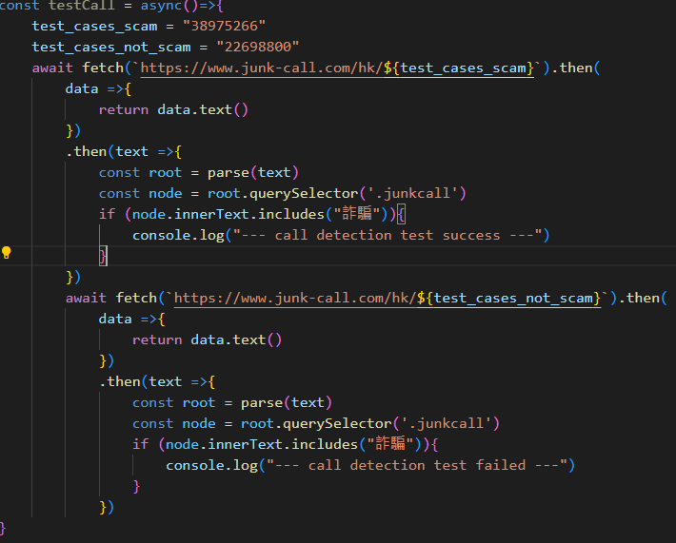
Testing – Deceptive Call Detection
2 phone numbers, one identified as deceptive one identified as safe retrieved from JunkCall HK website
Query the two phone numbers using the same code, expected to identify first one as deceptive and not to identify second one as deceptive

Slide 46
Other tests
Some features cannot be tested with a test case and must be tested manually
Other manual tests performed:
For LLM integration, simulate a chat and ask real life questions (e.g. how to go to HKU). Result: Appropriate response is given
For Location tracking, use an emulator to randomly set a location and observe if reflected on other linked devices. Result: successfully display same location in another device
For Deceptive call detection, find a deceptive phone number and simulate a call in emulator. Result: successfully identified
For Fall detection, free fall test and simulated falling test performed. Result: free fall test nearly always trigger detection due to bounceback. Simulate falling can detect around 7 falls out of 10.
For Body Status Monitoring, simulate out of range body status measurement in smartwatch emulator. Result: Failed. Google fit data cannot correctly sync to Google cloud. Stored in location storage instead of uploading to the cloud.

Slide 47
Limitations and Possible improvement – LLM integration
Google Gemini model needs VPN to access if locate in restricted area.
Some user may not be able to access it
Possible improvements:
Look for other LLM service that does not have area restriction
Host a server with LLM model loaded (need GPU resource to give acceptable inference time)

Slide 48
Limitations and Possible improvement – Deceptive Calls Filtering
Current mechanism heavily relies on JunkCall HK database
Can only detect deceptive phone number in Hong Kong
Possible improvement: find other services available in different regions, map the incoming phone number to corresponding service according to call code
List may not be comprehensive. Some deceptive calls not yet added to the list
Possible improvement: Use a speech recognition model to identify if suspicious keywords in phone conversation, e.g. “bank”, ”money”

Slide 49
Limitations and Possible improvement – Fall Detection
Current algorithm is simple and there is room for improvement
Possible improvement:
Can use more sensors, e.g. gyroscope and magnetometer, to assist in detection (Native development needed for their access)
Can design our own algorithm, for example retrieve falling data from elderly volunteer and train a machine learning model to find out the optimal set of parameters. A more complicated, multi-step algorithm can also be proposed.

Slide 50
Limitations and Possible improvement – Body Status Monitoring
Current limit provided by user, yet user may not know what is a good limit
Possible improvement:
Customize limit according to measured body status data from users
For example stochastically updating limit according to recent measurement of body status data, according to some algorithm, e.g. fixed margin between mean.

Slide 51
Future Direction
This application can be a prototype of a truly general-purposed, all-in-one elderly application
Can improve existing features, like suggested previously
Can also integrate new features that elderly need, e.g. cooperate with government or NGOs to organize events, provides welfare, or announcing important news

Slide 52
Conclusion
Noteworthy problems for elderly:
Telephone deception/Elderly missing/Accident/Generation gap
An app with below features:
Calls filtering/Location tracking/Smartwatch connectivity/Fall detection/GPT integration
Successfully build an app with most of the features accomplished, still have to fix the body status feature
This app could be a prototype of a general purpose, elderly-targeted application
Can improve current features and aggregate new features

Slide 53
Reference
[1] Anti-Deception Coordination Centre, Scam Statistics
https://www.adcc.gov.hk/en-hk/statistic.html (accessed: Oct 1, 2023)
[2] Security Bureau, Hong Kong Police Force, Legislative Council Panel on Security Initiatives for Preventing and Combatting Deception Cases, May 2021
https://www.legco.gov.hk/yr20-21/english/panels/se/papers/se20210601cb2-1110-3-e.pdf (accessed: Oct 1, 2023)
[3] Noemi Biancone, Chiara Bicchielli*, Fernando Ferri and Patrizia Grifoni, Multi-Sensor Fall Detection
for Smartphones, Published: March 23, 2021

Slide 54
Demo

Slide 55
Q & A

