Slide 1
COMP 4801 - Final Year Project First Presentation
Group: fyp23029
Member: Ng Tsz Hei (3035780192)
Project Title: All-in-one mobile application for elderly
Supervisor: Professor Wu, Chuan

Slide 2
Outline
Background
Motivation
Design and Methodology
Current and expected Results
Conclusion

Slide 3
Background
From July 2022 to July 2023:
- Number of telephone deception cases rises from
170 to 292 (71.8%)
- Monetary Loss rises from 65.65m to 94.2m (43.5%) [1]
- Situation worsening
According to Hong Kong Police Force, 494 out of 1150 victims (43%) are elderly in 2020 [2]
- Elderly accounts for a significant portion
Necessary to help them prevent telephone deception
Figure 1 Year-to-year Comparison in Telephone Deception in Hong Kong (July) [1]

Slide 4
Motivation
Problems except telephone deception:
- Elderly missing
- Accidents (e.g. fainting/falling)
- Generation gap
Problems of Existing applications:
- Not specially designed for elderly
- Elderly hard to manage many apps
An all-in-one mobile application for elderly is a good solution
Application name: Elder Link

Slide 5
Design (5 Main Features)
1) Calls Filtering
Scan incoming calls and compare to a list of suspicious phone number
2) Location Tracking
Constantly keep track on elderly's location and assist searching in case of missing
3) Smartwatch Connectivity
Connect to smartwatch and monitor the body status of elderly
4) Fall Detection
Use built in accelorometer of the phone to track the phone acceleration and detect falling
5) GPT integration
Integration GPT as a chatbot to assist problem solving

Slide 6
Methodology
System Modelling:
Lucidchart for UML diagrams (system architecture) and ER diagrams (database design)
User Interface Design:
Figma (interactive & convertable to code)
Front end:
React Native (cross platform & support Android and IOS phones)
Backend:
Google Firebase (good security & easy setup)
Version Control:
Github (project management features)

Slide 7
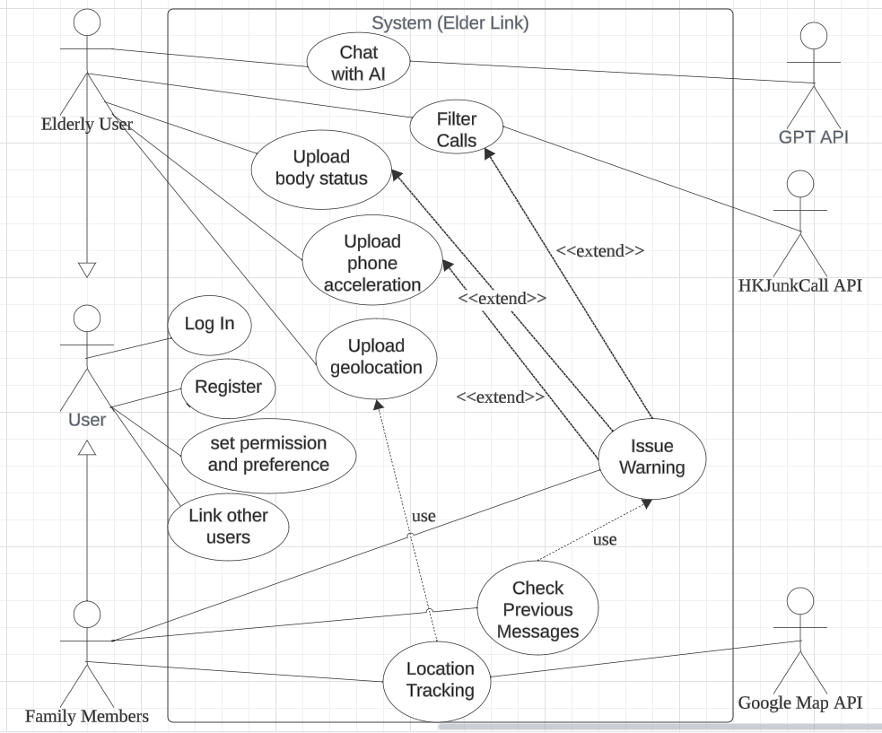
Current Result – System Design
2 types of targeted users – elderly and family members
All users:
- Log in
- Register
- Set permission & preference
- Link other users
Figure 2 Use Case Diagram of Elder Link

Slide 8
Current Result – System Design
Elderly users:
- chat with AI (call GPT API)
- Filter incoming calls (call HKJunkCall API)
- Track body status/phone acceleration/geolocation in background
- Occasionally issue warning in case suspicious call/falling/dangerous body status
Figure 2 Use Case Diagram of Elder Link

Slide 9
Current Result – System Design
Linked family users:
- Track location uploaded by elderly users (call Google Map API)
- Receive warning
- Check previous messages(warning) issued
Figure 2 Use Case Diagram of Elder Link

Slide 10
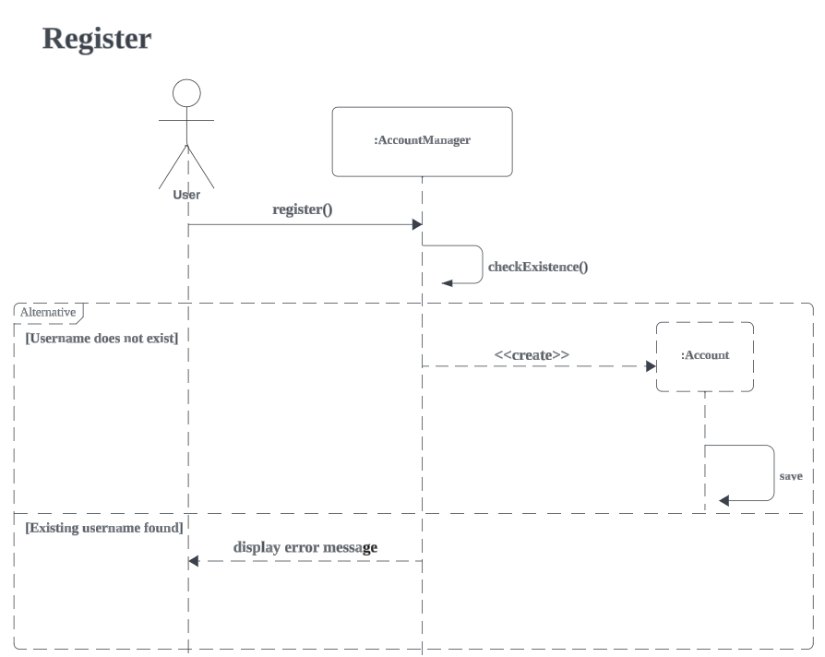
Current Result – System Design
User send username, password, display name
Account Manager checks if username exists in database
If no duplicated username, Account Manager creates account object and save in database
If duplicated, display error message
Figure 3 Sequence Diagram for register

Slide 11
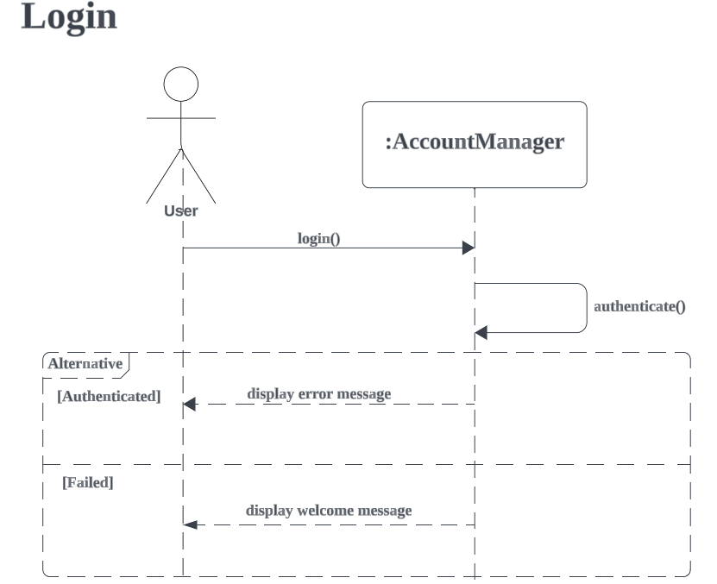
Current Result – System Design
User logins with username, password
Account Manager checks database record and authenticates
If success, send welcome message and navigate to main page
If fail, send error message
Figure 4 Sequence Diagram for login

Slide 12
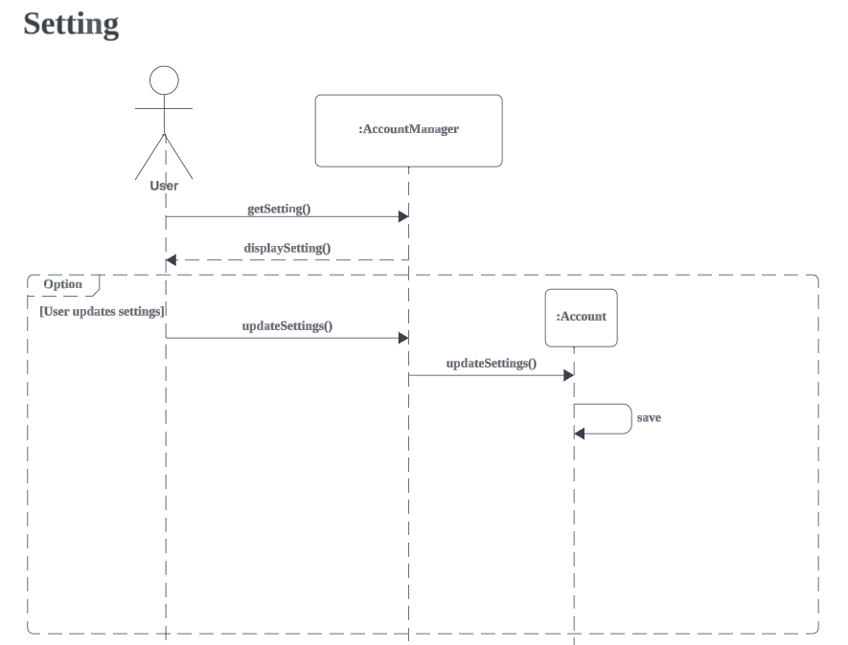
Current Result – System Design
User retrieves up-to-date settings and settings displayed
If user chooses to update, AccountManager updates account object
Save updated account object to database
Figure 5 Sequence Diagram for setting

Slide 13
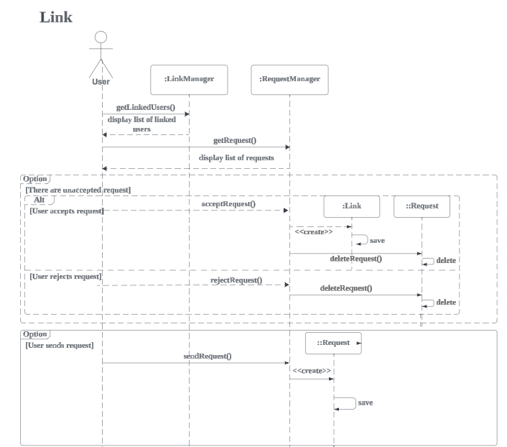
Current Result – System Design
User gets linked users list and requests
If user accepts, create link and save to database. Then delete request anyway.
If user sends a request, create request object and store in database.
Figure 6 Sequence Diagram for link

Slide 14
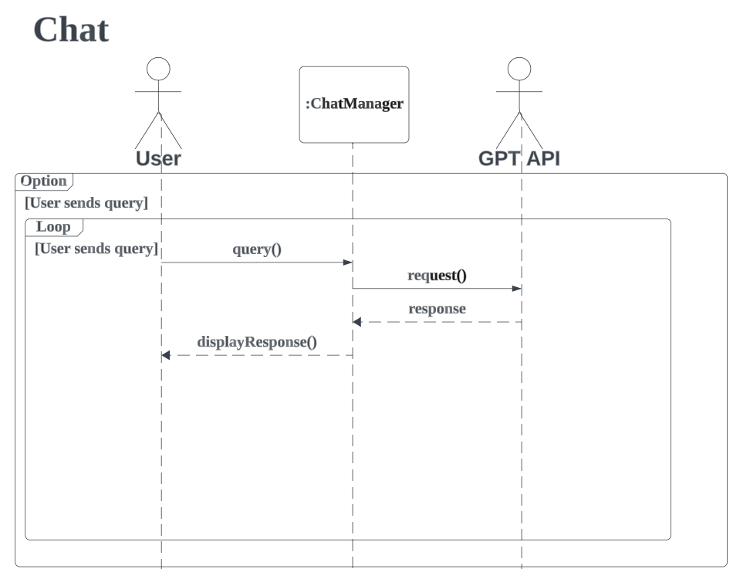
Current Result – System Design
If user sends query, ChatManager sends request to GPT API.
ChatManager receives response from GPT API and display to user.
Figure 7 Sequence Diagram for chat

Slide 15
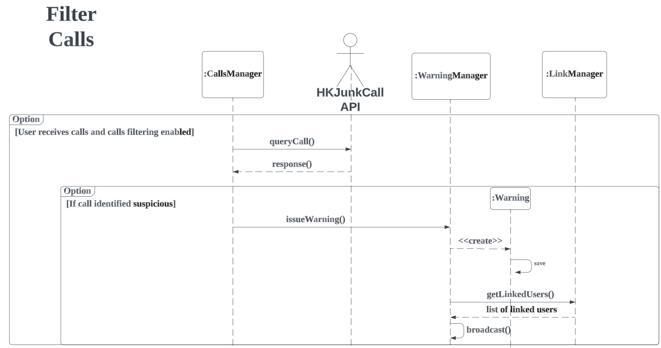
Current Result – System Design
If user receives call, CallsManager query phone number with HKJunkCall API.
If identified suspicious, call WarningManager with warning string.
WarningManager create Warning object, save it in database, then get list of linked users and broadcast message
Figure 8 Sequence Diagram for filter calls

Slide 16
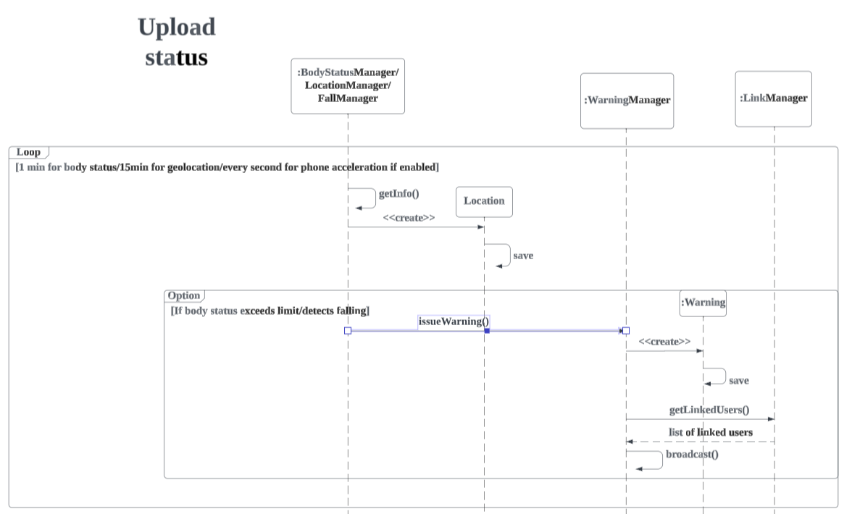
Current Result – System Design
For every 1min/15min/1second, BodyStatus/Location/FallManager retrieve respective data.
Location Manager creates Location object and store in database.
If body status exceeds limit/fall detected, issues and broadcast warning like before
Figure 9 Sequence Diagram for upload status

Slide 17
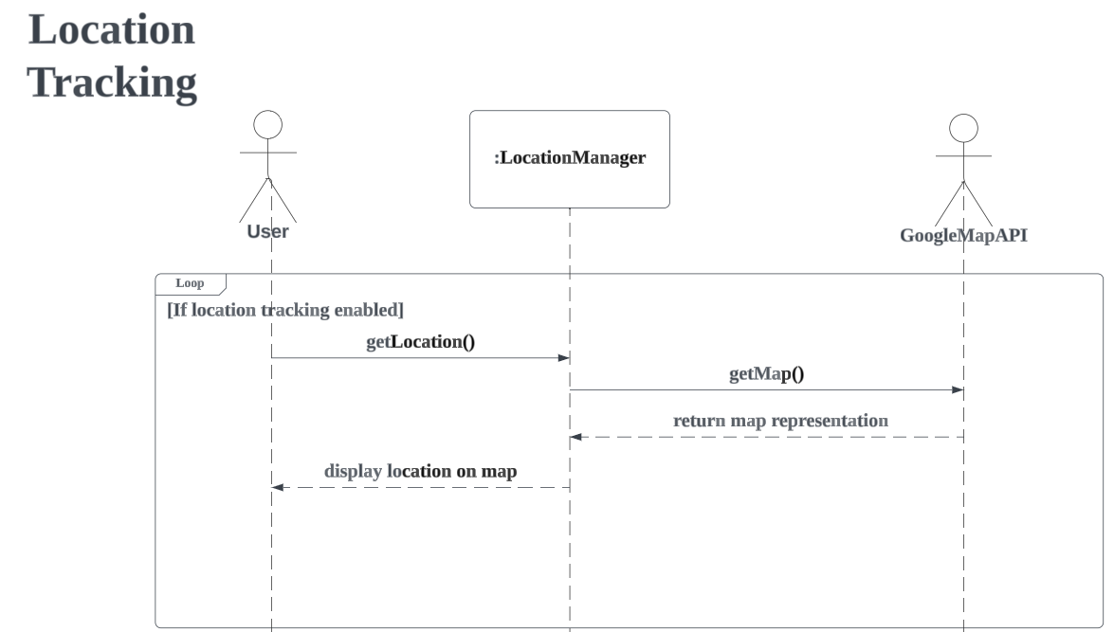
Current Result – System Design
If users enabled location tracking, get location from LocationManager
LocationManager then read info in database and call Google Map API to get map representation
Location with map is displayed to users
Figure 10 Sequence Diagram for location tracking

Slide 18
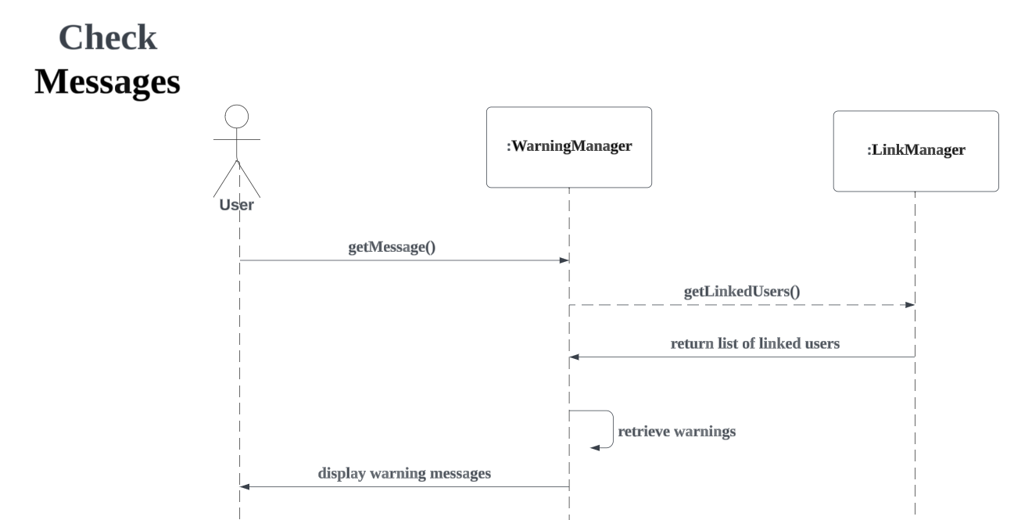
Current Result – System Design
User calls to get previous warning messages from WarningManager
WarningManager gets a list of linked users from LinkManager and retrieve warning messages in database
WarningManager displays warning messages to users
Figure 11 Sequence Diagram for check message

Slide 19
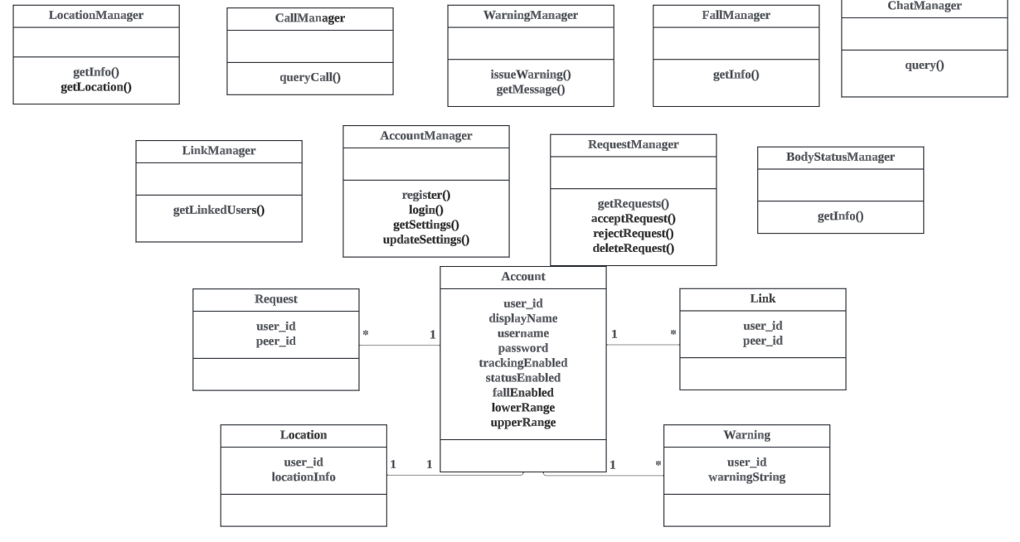
Current Result – System Design
- Managers
- Account, Link, Request, Location, Warning classes
Figure 12 Class Diagram of the Application

Slide 20
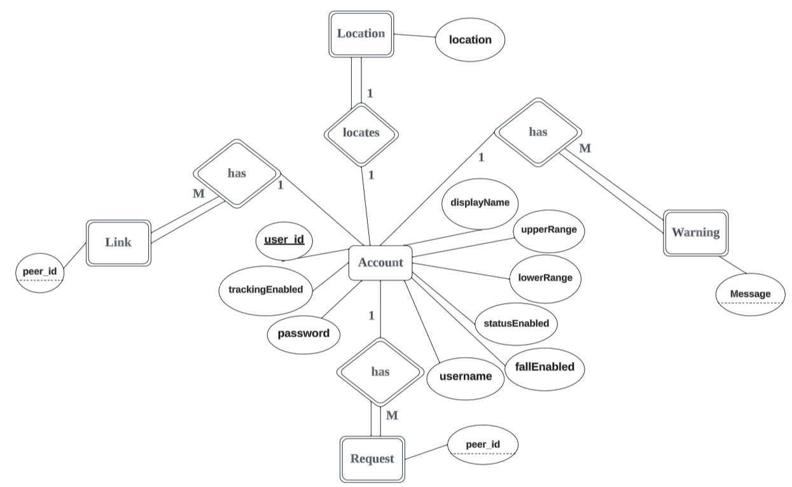
Current Result – Database Design
Account entity
Attributes:
User id / username / password / trackEnabled / statusEnabled / fallEnabled / lowerRange / upperRange
Relationship:
Location (1 to 1)
Warning (1 to many)
Link (1 to many)
Request (1 to many)
All partial participation
Figure 13 Entity Relationship Diagram of the Application

Slide 21
Current Result – Database Design
Link entity (weak entity)
Attributes:
Peer_id
Relationship:
Account (many to 1)
Total participation
Foreign key: user_id referencing Account
Figure 13 Entity Relationship Diagram of the Application

Slide 22
Current Result – Database Design
Location entity (weak entity)
Attributes:
location
Relationship:
Account (1 to 1)
Total participation
Foreign key: user_id referencing Account
Figure 13 Entity Relationship Diagram of the Application

Slide 23
Current Result – Database Design
Warning entity (weak entity)
Attributes:
Message
Relationship:
Account (many to 1)
Total participation
Foreign key: user_id referencing Account
Figure 13 Entity Relationship Diagram of the Application

Slide 24
Current Result – Database Design
Request entity (weak entity)
Attributes:
Peer_id
Relationship:
Account (many to 1)
Total participation
Foreign key: user_id from Account
Figure 13 Entity Relationship Diagram of the Application

Slide 25
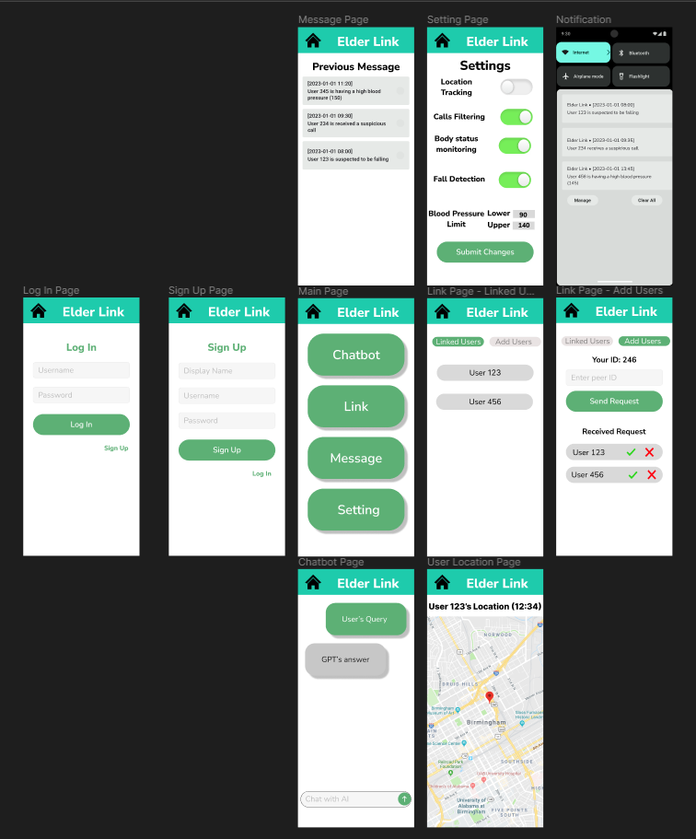
Current Result – User Interface Prototype
Figure 15 Figma UI Prototype

Slide 26
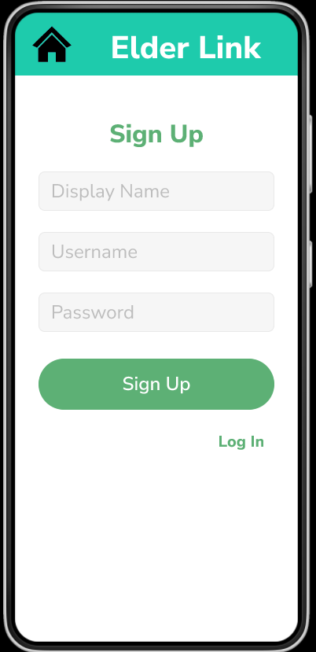
Current Result – User Interface (Login & Signup)
Figure 16, 17 Login and Signup Pages

Slide 27
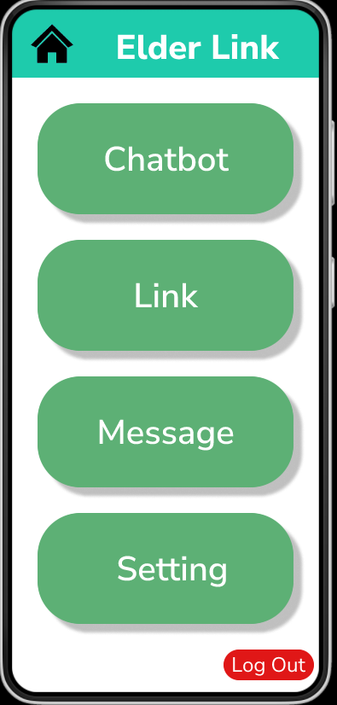
Current Result – User Interface Main Page
Navigation to :
- Chatbot
- Link
- Message
- Setting
Log out button
Figure 18 Main Page

Slide 28
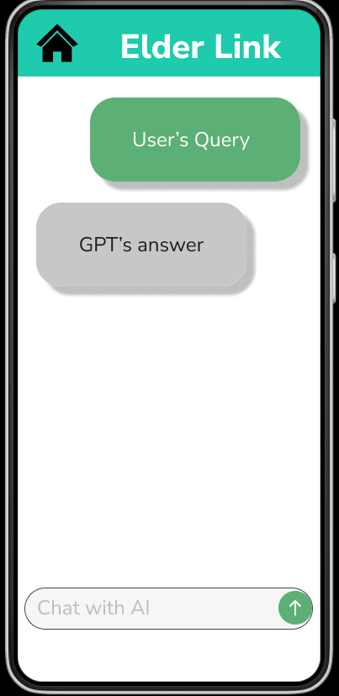
Current Result – User Interface Chatbot Page
Figure 19 Chatbot Page

Slide 29
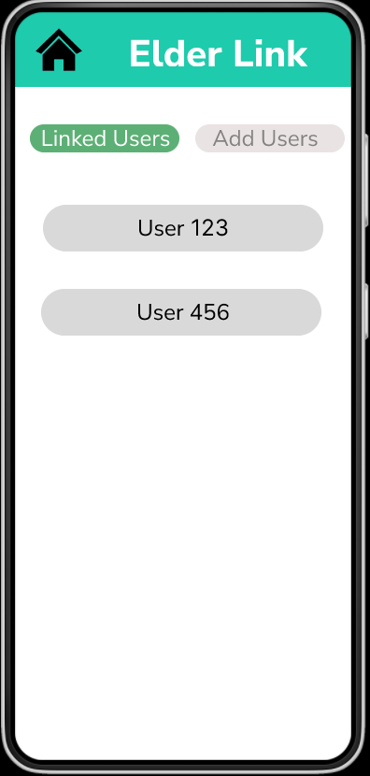
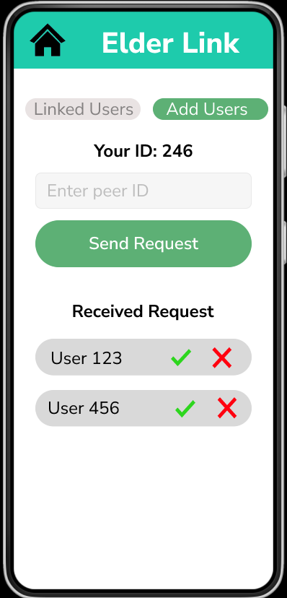
Current Result – User Interface Link Page
Figure 20-22 Linked users, user location, add users pages

Slide 30
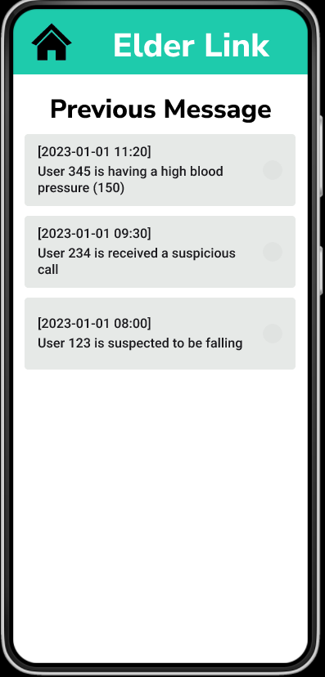
Current Result – User Interface Message Page
- Display previous warning messages
Figure 23 Messages Page

Slide 31
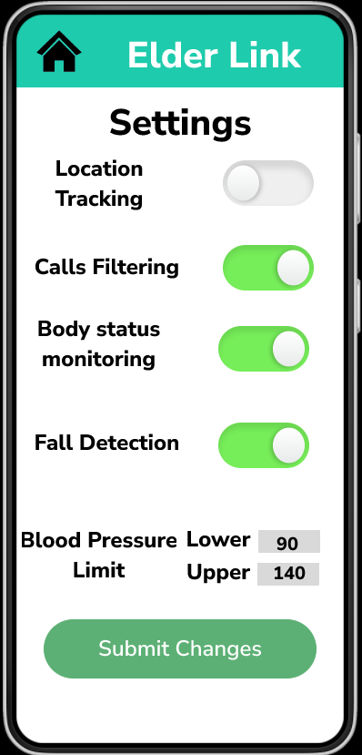
Current Result – User Interface Setting Page
Toggle button to enable / disable functions
Text boxes to enter upper/lower blood pressure limits
Submit button to save changes
Figure 24 Setting Page

Slide 32
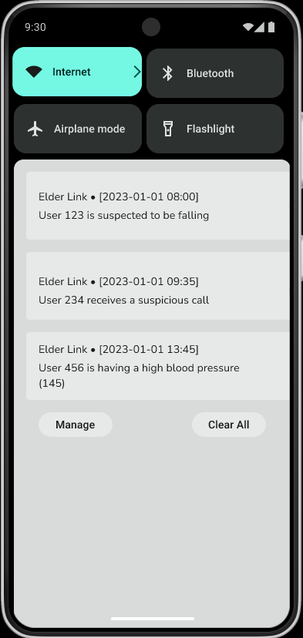
Current Result – User Interface Warning Notification
Sample notification if linked users trigger warning
Figure 25 Warning Notification

Slide 33
Expected Future Results
Testing & Implementation
Test-driven development
Design test cases first, testing interleaves with implementation
Related set of documents(report, poster, video)

Slide 34
Conclusion
Noteworthy problems for elderly:
Telephone deception/Elderly missing/Accident/Generation gap
An app with below features:
Calls filtering/Location tracking/Smartwatch connectivity/Fall detection/GPT integration

Slide 35
Conclusion
Progress in first semester (Sep-Dec):
- Proposal
- System modelling (UML diagram)
- Database design (ER diagram)
- Figma UI prototype
Plan in second semester (Jan-Apr):
- Testing
- Implementation
- Related documents

Slide 36
Reference
[1] Anti-Deception Coordination Centre, Scam Statistics
https://www.adcc.gov.hk/en-hk/statistic.html (accessed: Oct 1, 2023)
[2] Security Bureau, Hong Kong Police Force, Legislative Council Panel on Security Initiatives for Preventing and Combatting Deception Cases, May 2021
https://www.legco.gov.hk/yr20-21/english/panels/se/papers/se20210601cb2-1110-3-e.pdf (accessed: Oct 1, 2023)

Slide 37
Q & A

