Slide 1
Strengthening Youths’ Competencies for Mental Health Self-care
Final Year Project Final Presentation
Yau Herman (3035570054)
Supervised by Dr. Schnieders Dirk
Notes:
Introduction – 3m30s
Methodology – 2ms
Demonstration – 3m
Results – 1m30s
Conclusion – 2m
Total: 12m (Buffer to 12m30s)

Slide 2
Table of Contents
01
02
03
05
Introduction
Methodology
Demonstration
04
Results
Conclusion

Slide 3
01
Introduction

Slide 4
Physical vs Mental Health
People illustrations by Storyset
Notes:
https://www.ncbi.nlm.nih.gov/pmc/articles/PMC5381426/
Mun, Sujeong et al, “Self-care use patterns in the UK, US, Australia, and Japan: a multinational web-based survey,” Integrative medicine research vol. 5,2, 2016.

Slide 5
Physical vs Mental Health
Physical
Mental
People illustrations by Storyset
Notes:
https://www.ncbi.nlm.nih.gov/pmc/articles/PMC5381426/
Mun, Sujeong et al, “Self-care use patterns in the UK, US, Australia, and Japan: a multinational web-based survey,” Integrative medicine research vol. 5,2, 2016.

Slide 6
Mental Health Problems are Prevalent
1 in 8 people
are living with a
common mental health condition. ^{[1]}
[1] GBD Results Tool. Global Health Data Exchange (n.d.). Seattle: Institute for Health Metrics and Evaluation [Online].
Notes:
970 million
GBD Results Tool. Global Health Data Exchange (n.d.). Seattle: Institute for Health Metrics and Evaluation [Online]. Available: https://ghdx.healthdata.org/gbd-results-tool?params=gbd-api-2019-permalink/2537ec0fb3bbbf9114a868394976128b, [Accessed: 25 March 2022].

Slide 7
Poor Mental Health causes Suffering ^{[3]}
Worsened
Academic Performance
Reduced
Productivity
Increased
Economic Costs
Premature
Mortality
Suicides
[3] World Health Organization, “World mental health report. Transforming mental health for all,” 2022.
Notes:
World Health Organization, “World mental health report. Transforming mental health for all,” Geneva: World Health Organization, 2022.

Slide 8
Self-care is an Effective Intervention Measure
Can be as effective as face-to-face consultations. ^{[4]}
Images from Freepik
[4] Cuijpers P, Donker T, van Straten A, Li J, and Andersson G, “Is guided self-help as effective as face-to-face psychotherapy for depression and anxiety disorders? A systematic review and meta-analysis of comparative outcome studies,” Psychol Med. 2, 2010.
Notes:
Activities that individuals do to improve their help without interventions from professionals
Freepik
Cuijpers P, Donker T, van Straten A, Li J, and Andersson G, “Is guided self-help as effective as face-to-face psychotherapy for depression and anxiety disorders? A systematic review and meta-analysis of comparative outcome studies,” Psychol Med. 2, 2010.

Slide 9
Self-care is Underrated
People who engage in self-care actively. ^{[5]}
[5] Mun, Sujeong et al, “Self-care use patterns in the UK, US, Australia, and Japan: a multinational web-based survey,” Integrative medicine research vol. 5,2, 2016.
Notes:
https://www.ncbi.nlm.nih.gov/pmc/articles/PMC5381426/
Mun, Sujeong et al, “Self-care use patterns in the UK, US, Australia, and Japan: a multinational web-based survey,” Integrative medicine research vol. 5,2, 2016.

Slide 10
If self-care is beneficial but underutilized,
Can I make more people do it?
People illustrations by Storyset

Slide 11
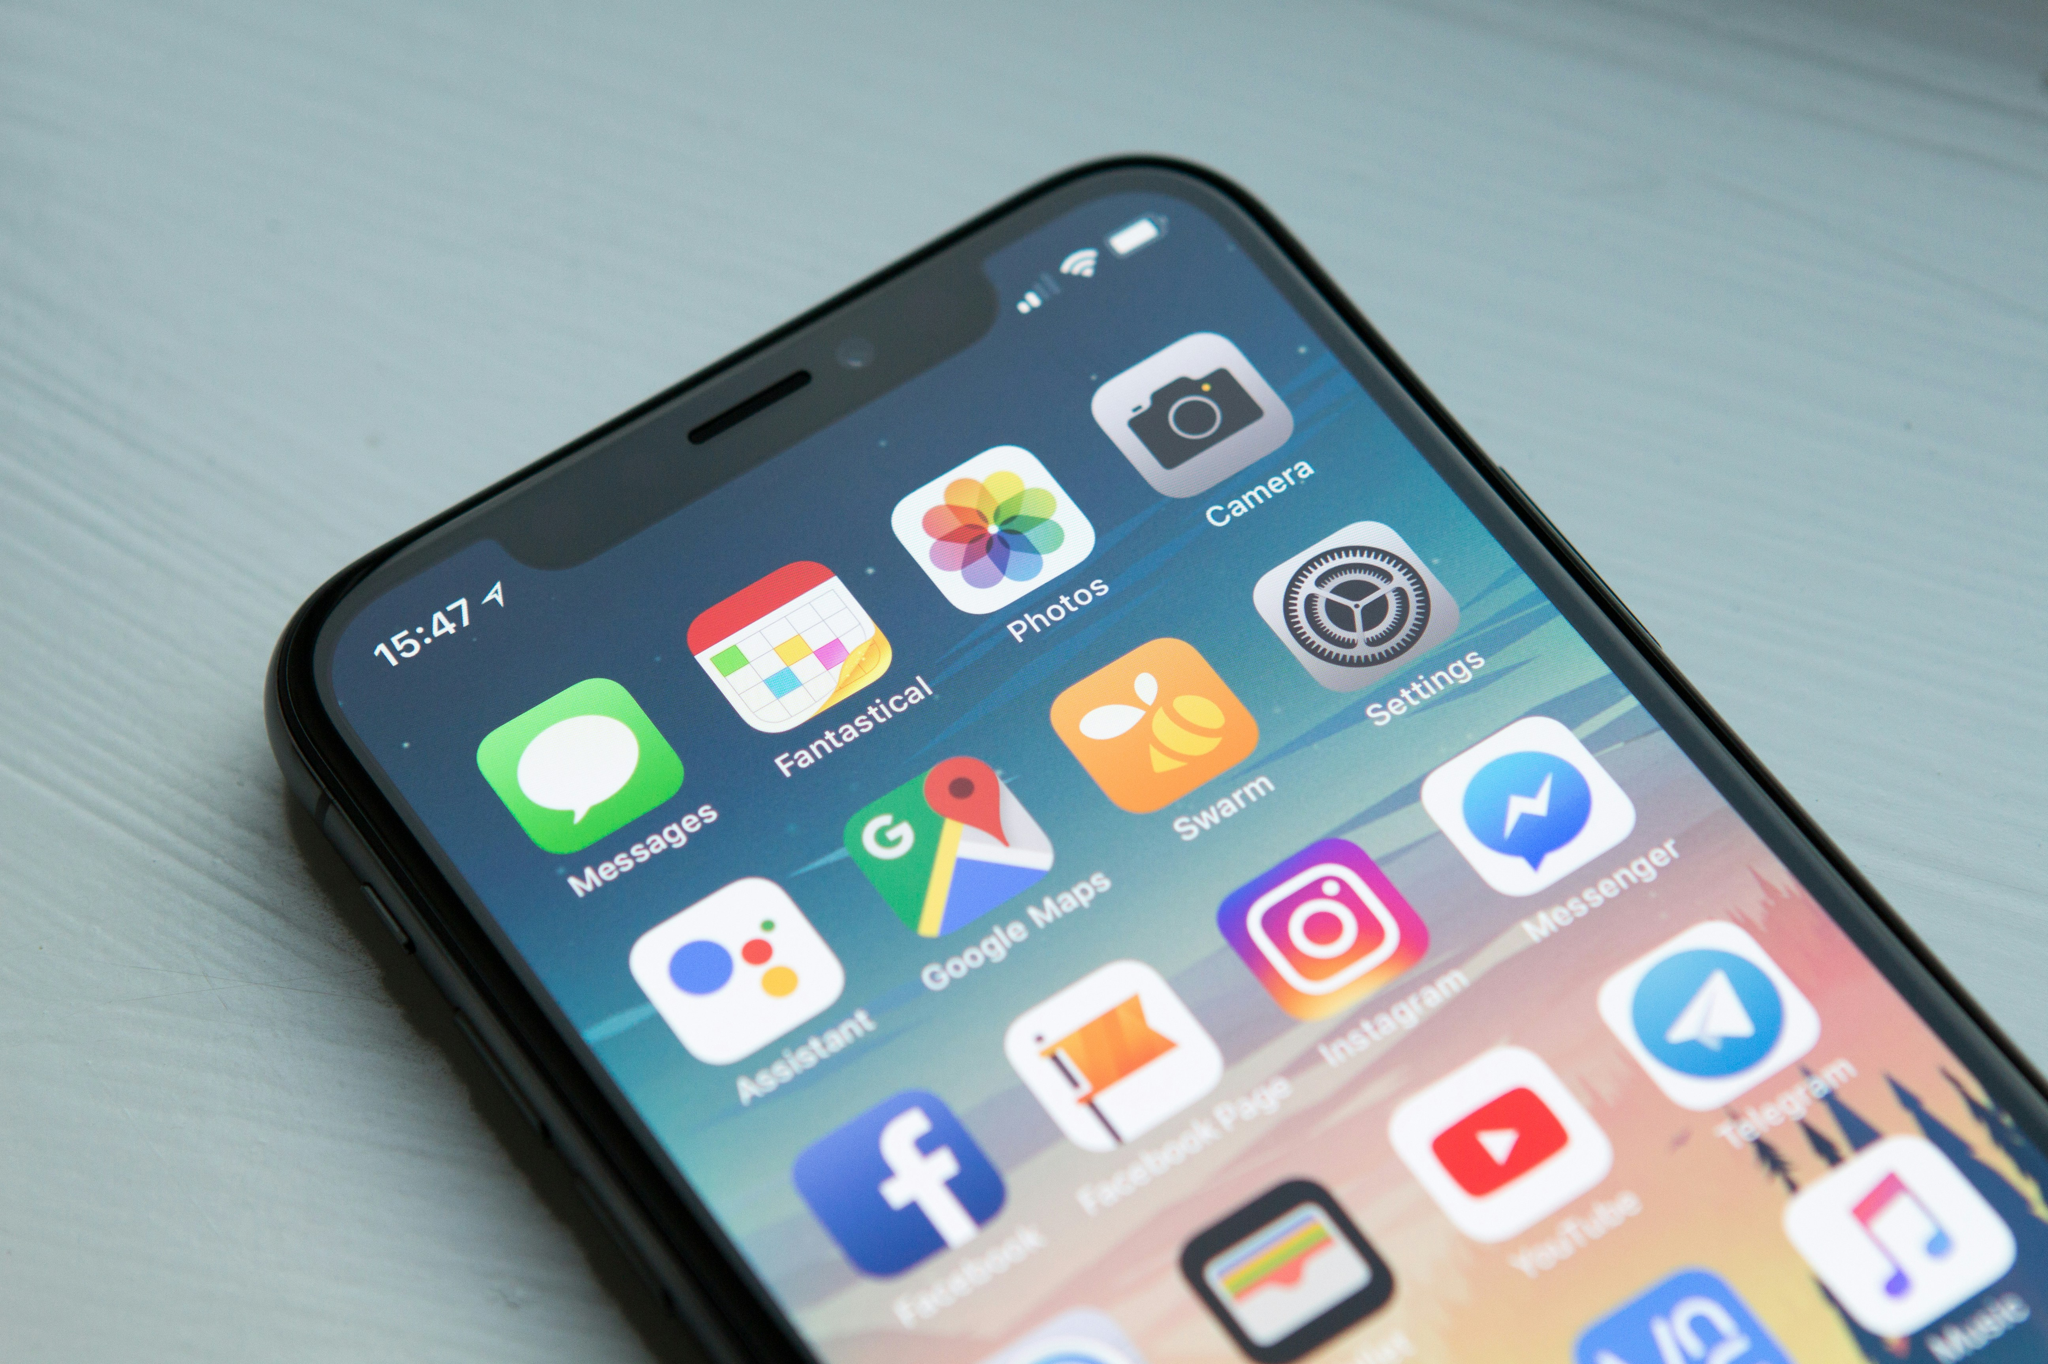
Current Solutions are Inadequate
More Engaging
Counselling
More Accessible
Physical Self-care Products
Self-care Apps
Images from Unsplash.

Slide 12
Project Aims
Create a mobile game application.
Provide mental health information.
Help youths to incorporate self-care routine.
Help solve mental health problems.
Notes:
Mention not about diagnosis
Mention not about monitoring users to perform self-care

Slide 13
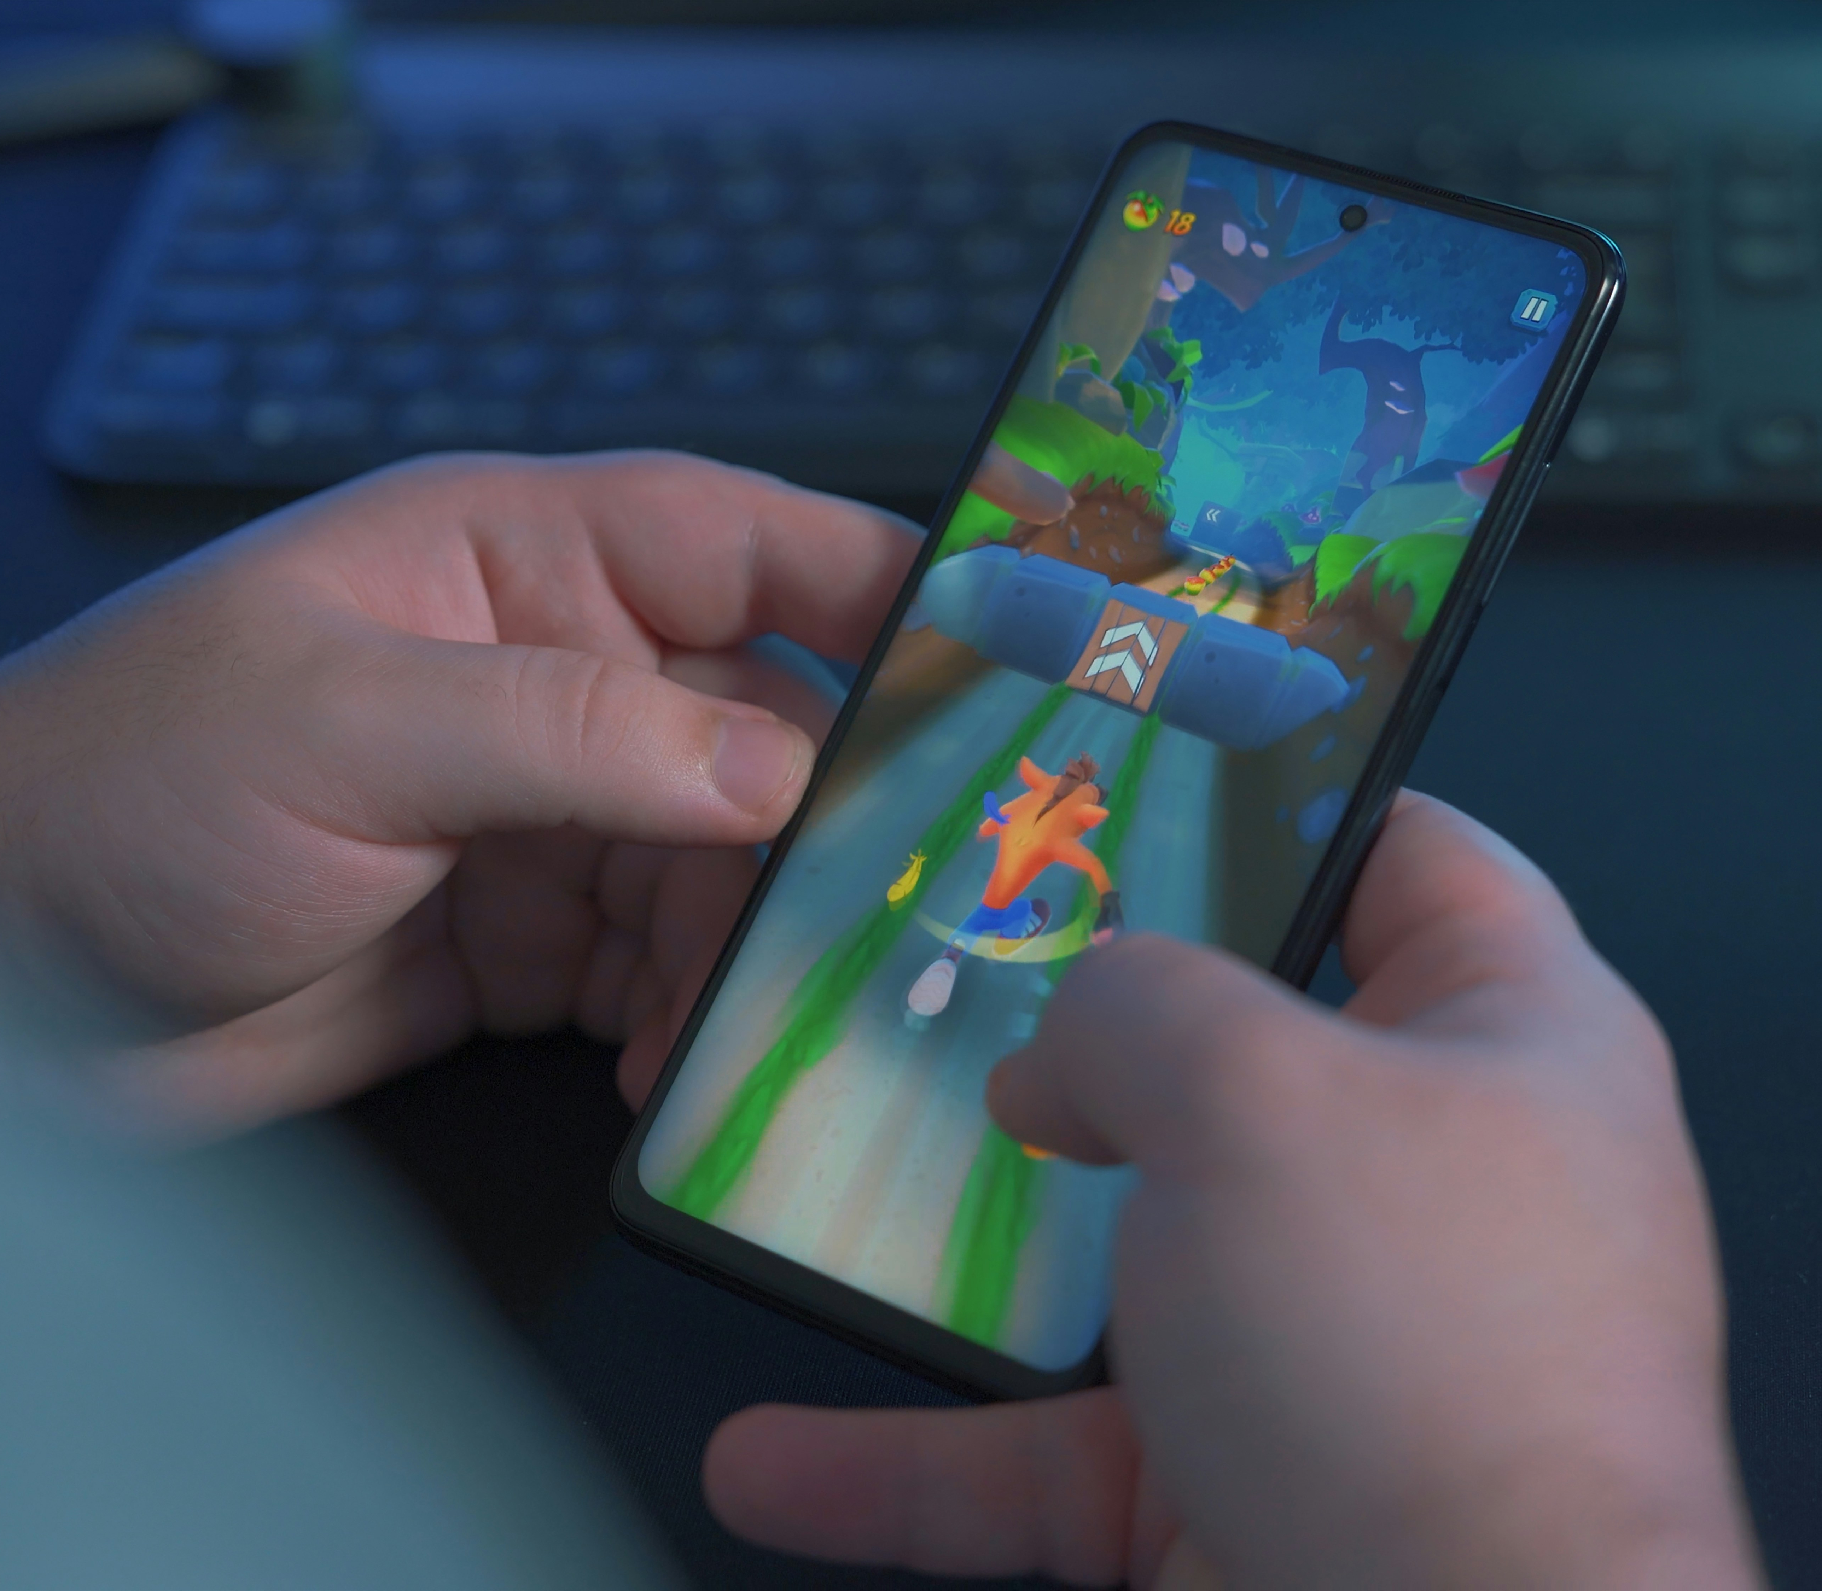
Mobile Game is a more Desirable Solution
More Appealing
Habit-forming
More Convenient
More Affordable
Image from Unsplash.

Slide 14
02
Methodology

Slide 15
Project Stages
1. Design
2. Development
3. Evaluation

Slide 16
Design Stage
1. Design
2. Development
3. Evaluation
Product Design
UI Design
Prototyping

Slide 17
Concept Design
Evaluate current emotion state.
Perform self-care in real life.
Defeat in-game enemies.
Wait till tomorrow.

Slide 18
Development Stage
1. Design
2. Development
3. Evaluation
Game Engine & Analytics SDK
Programming Language
UI SDK

Slide 19
Development Stage
1. Design
2. Development
3. Evaluation
(Github)
Version Control
Repository Server
Code Generation

Slide 20
Evaluation Stage
1. Design
2. Development
3. Evaluation
App Publication
Data Collection
Data Analysis

Slide 21
App Publication
(Apple App Store)
$99 USD / Year
One-off $25 USD

Slide 22
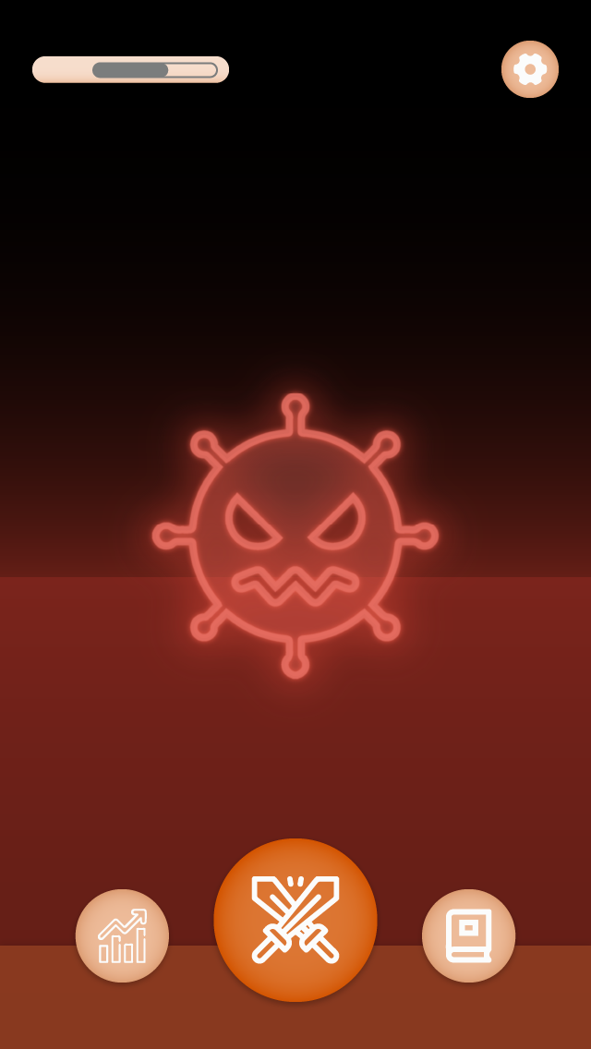
Data Collection
Usage Data
Consent will be requested.
Client
Analytics Service

Slide 23
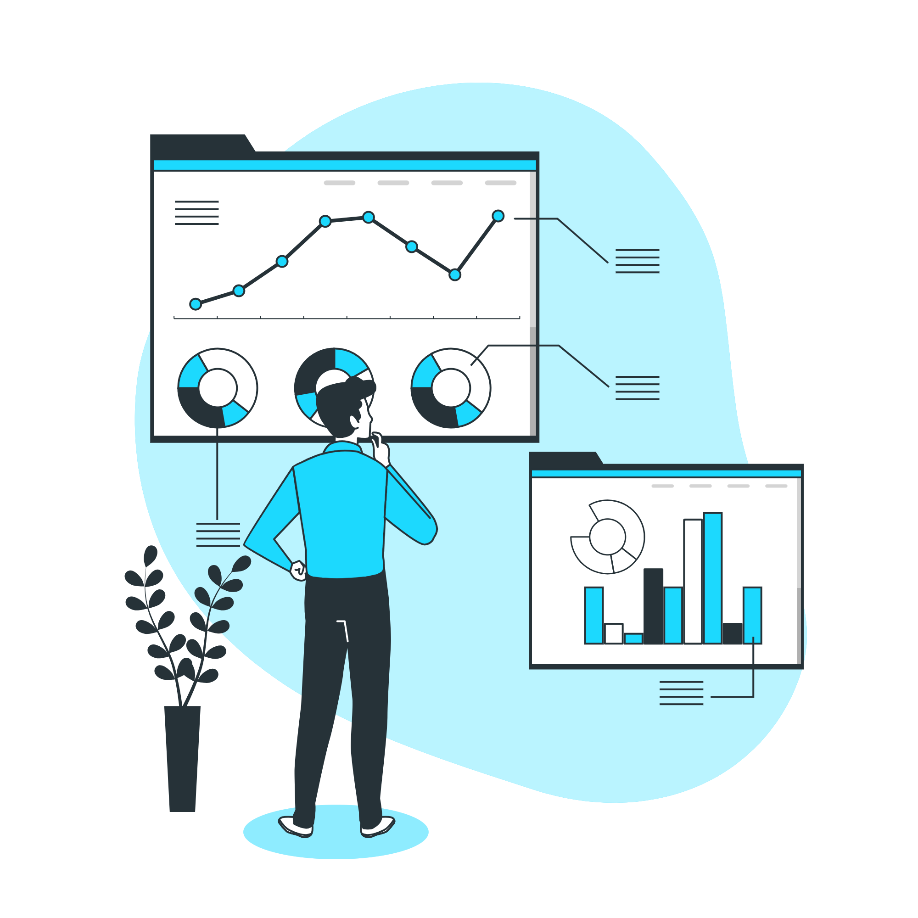
Data Analysis
User Emotion Scores
User Retention Rate
Application Crash Rate
People illustrations by Storyset

Slide 24
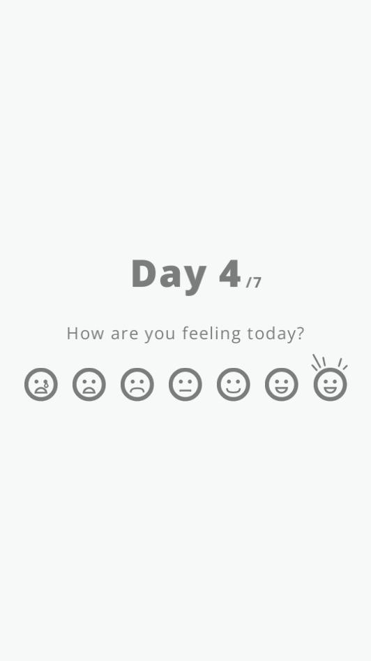
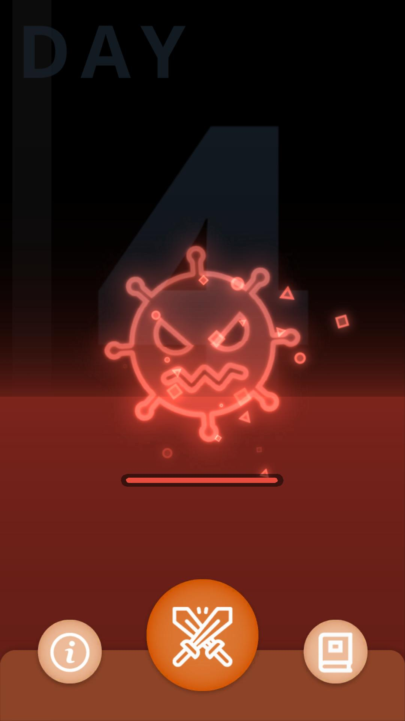
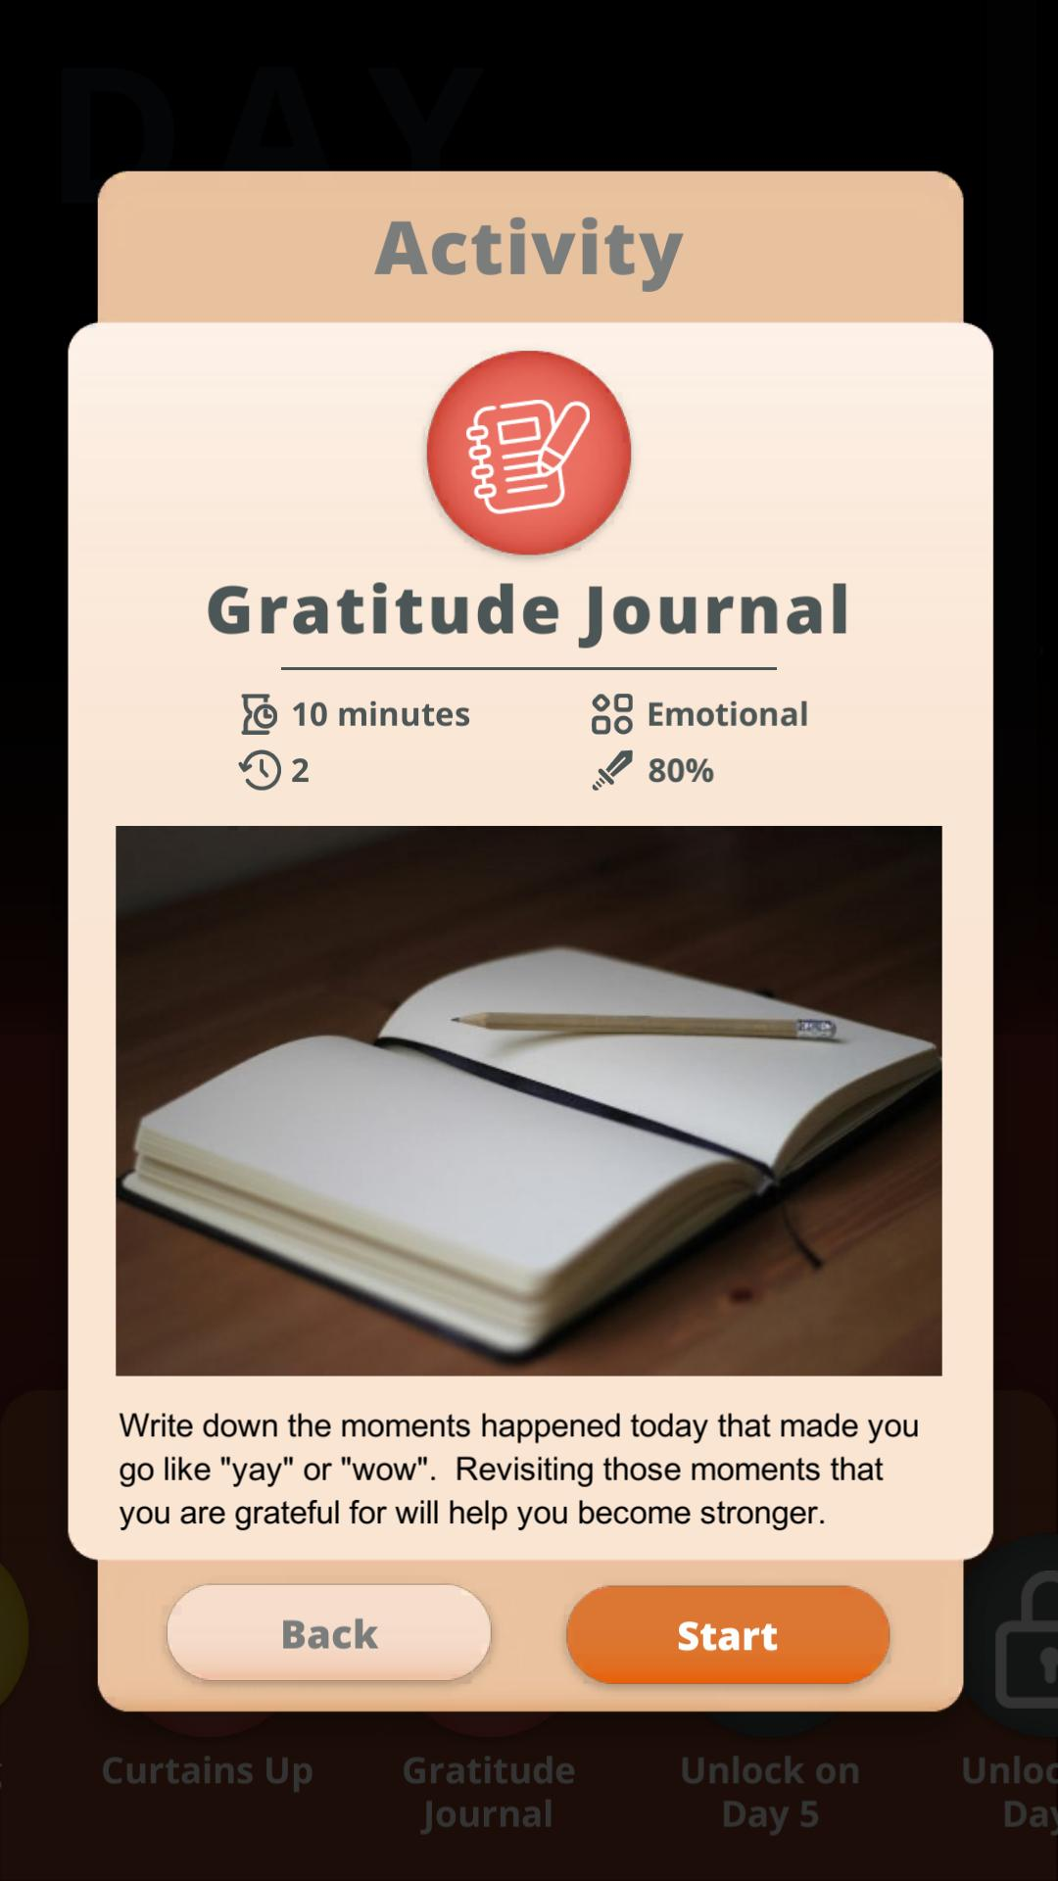
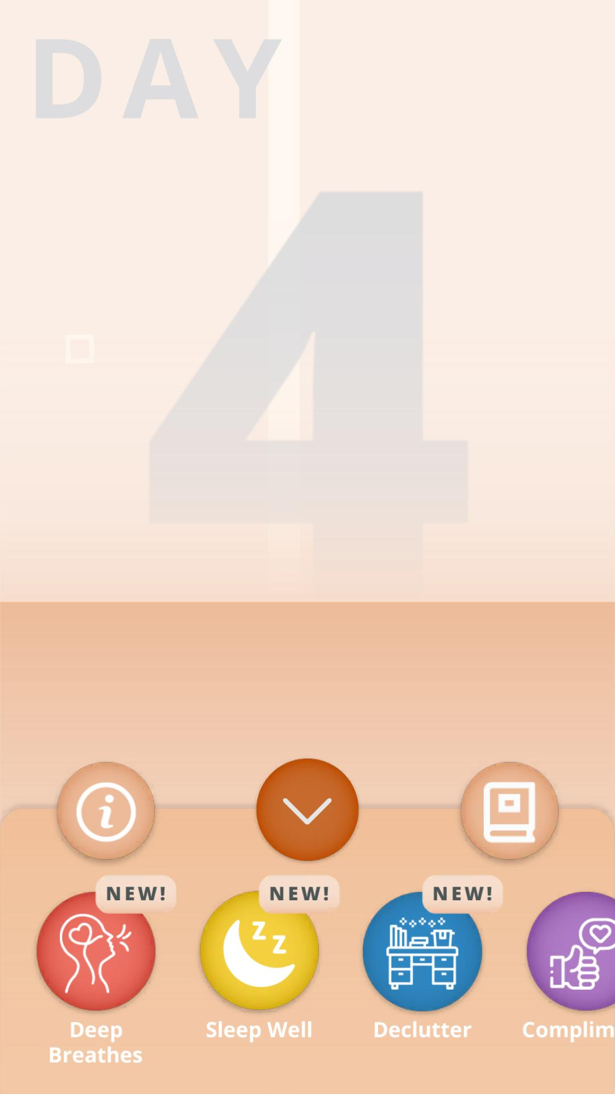
User Emotion Scores
Self-evaluation
7-point-scale

Slide 25
03
Demonstration

Slide 26
04
Results

Slide 27
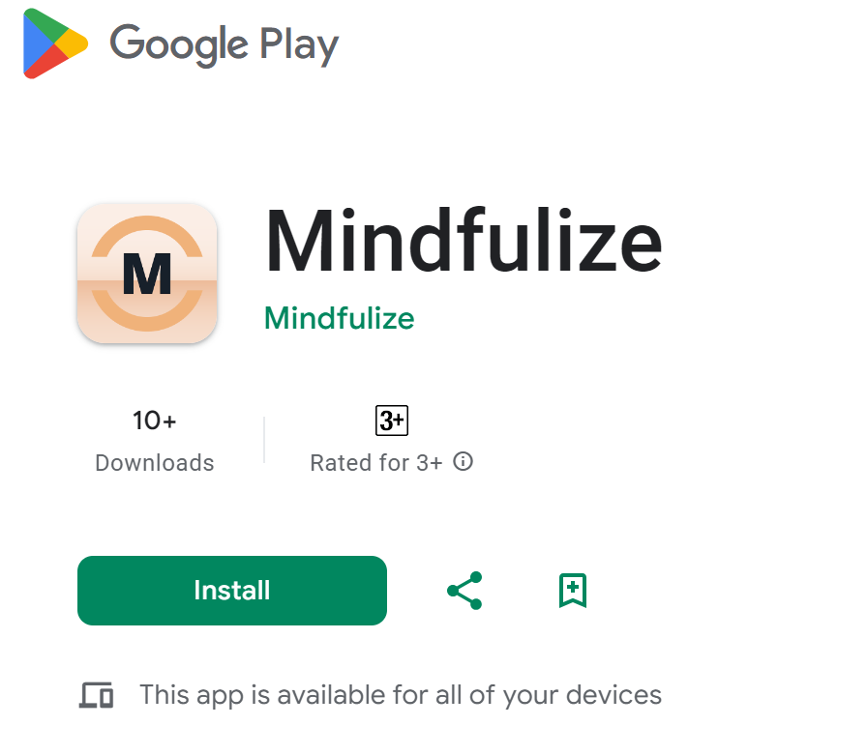
App Publication Status
15
Downloads
0
Crash Reports
Data is captured on 18th April 2024.

Slide 28
User Emotion Score
Data is captured on 18th April 2024.

Slide 29
User Count
Data is captured on 18th April 2024.

Slide 30
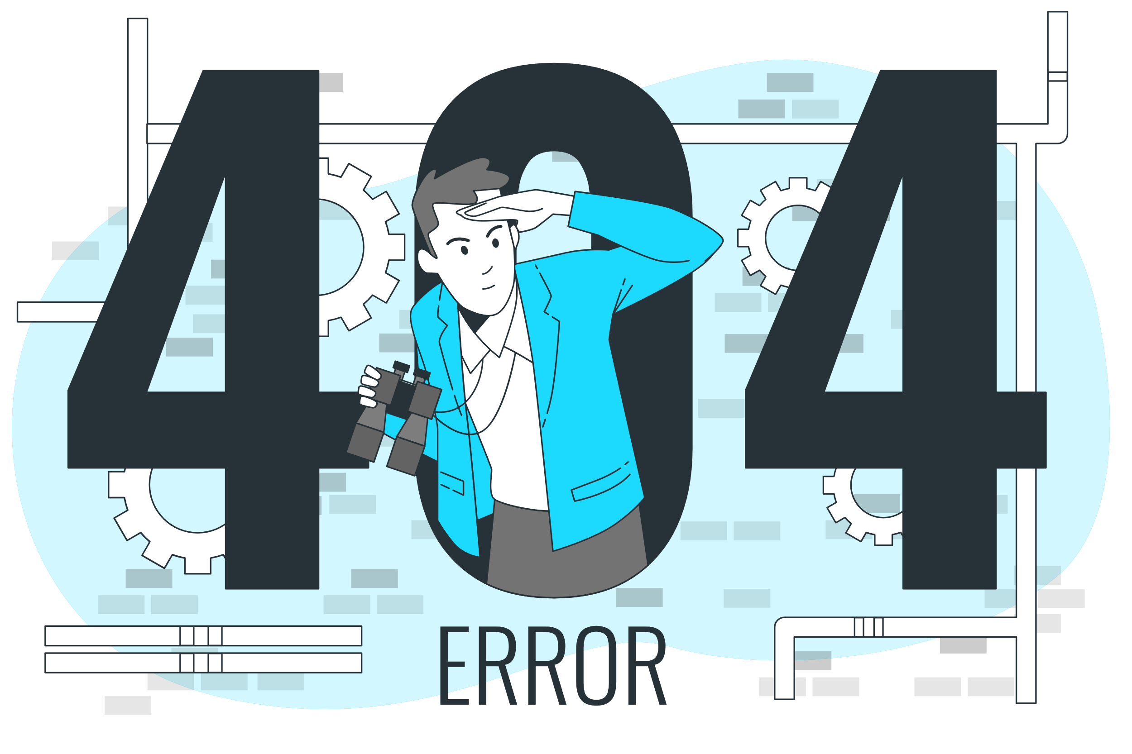
What Went Wrong?
No Public Access
Small Sample Size
People illustrations by Storyset

Slide 31
05
Conclusion

Slide 32
Evaluation and societal impact is dependent on user base size.
Conclusion #1
A foreseen limitation that is not mitigated due to the limited project scope.
People illustrations by Storyset
Notes:
Users are expected to use the application for an extensive period of time before seeing improvement in their health
Willing to participate for such long time period
Attempt to seek alternative solutions to collect data upon further research
Data illustrations by Storyset

Slide 33
Discrepancies exist between self and professional evaluation.^{[8]}
Conclusion #2
Self-evaluation can still serve as a rough indicator due to its lower cost.
Image from Unsplash, [8] Enns, Murray W., Derrick K. Larsen, and Brian J. Cox. "Discrepancies between self and observer ratings of depression: the relationship to demographic, clinical and personality variables." Journal of affective disorders 60, no. 1, 2000
Notes:
https://www.sciencedirect.com/science/article/pii/S0165032799001561?via%3Dihub

Slide 34
A more interactive way of data collection is shown.
Conclusion #3
Games provide an alernate way to collect data that can be potentially more comprehensive.
Image from Unsplash.
Notes:
Users are expected to use the application for an extensive period of time before seeing improvement in their health
Willing to participate for such long time period
Attempt to seek alternative solutions to collect data upon further research
Data illustrations by Storyset

Slide 35
Conclusion
Introduction
Self-care is beneficial yet underrated
Methodology
A mobile game application has been developed
Results
Development is completed with some data collected
Conclusion
Project has limitations that future works can improve on.
Notes:
In conclusion, in this presentation, I explained the importance of promoting mental self-care
And therefore a mobile game application will be developed in this project to achieve such goal
The project has foreseen limitations, and it will try to mitigate some of them
Currently, the product…

Slide 36
References
[1] GBD Results Tool. Global Health Data Exchange (n.d.). Seattle: Institute for Health Metrics and Evaluation [Online]. Available: https://ghdx.healthdata.org/gbd-results-tool?params=gbd-api-2019-permalink/2537ec0fb3bbbf9114a868394976128b, [Accessed: 25 March 2023].
[2] South China Morning Post. “1.6% of Hong Kong secondary school pupils tried to take their own lives last year and 3.7% considered it, major survey finds“[Online]. Available: https://www.scmp.com/news/hong-kong/health-environment/article/3247176/16-hong-kong-secondary-school-pupils-tried-take-their-own-lives-last-year-and-37-considered-it-major, [Accessed: 09 January 2024].
[3] World Health Organization, “World mental health report. Transforming mental health for all,” Geneva: World Health Organization, 2022.
[4] Cuijpers P, Donker T, van Straten A, Li J, and Andersson G, “Is guided self-help as effective as face-to-face psychotherapy for depression and anxiety disorders? A systematic review and meta-analysis of comparative outcome studies,” Psychol Med. 2, 2010.
[5] Mun, Sujeong et al, “Self-care use patterns in the UK, US, Australia, and Japan: a multinational web-based survey,” Integrative medicine research vol. 5,2, 2016.
[6] Griffiths, M. D., Kuss, D. J., & King, D. L., “Video game addiction: Past, present and future”. Current Psychiatry Reviews, 2012.
[7] Jason Steadman, Chelsea Boska , Crystal Lee , Xuan-Shi Lim and Natalie Nichols, “Using Popular Commercial Video Games in Therapy with Children and Adolescents”, Journal of Technology in Human Services, 2014.
[8] Enns, Murray W., Derrick K. Larsen, and Brian J. Cox. "Discrepancies between self and observer ratings of depression: the relationship to demographic, clinical and personality variables." Journal of affective disorders 60, no. 1, 2000

Slide 37
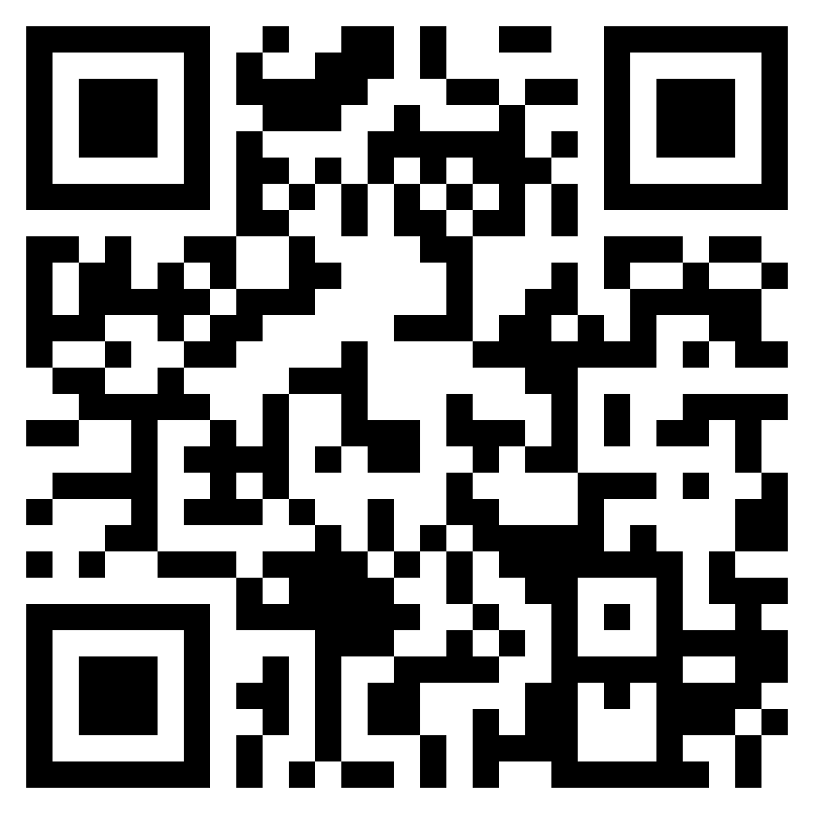
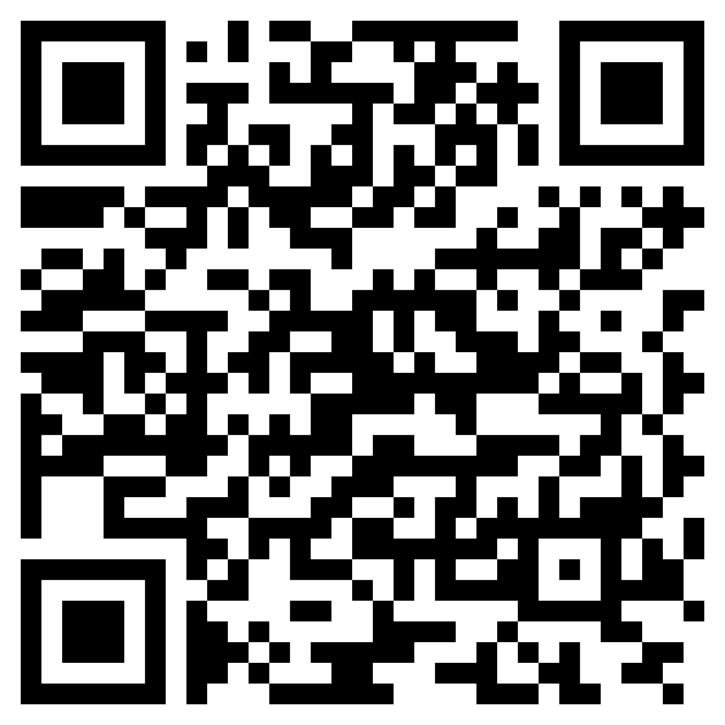
Thank You!
Try the game!
(Android Devices Only)
Step 1
Step 2
Join the Google group.
Download from Play Store.

