Slide 1
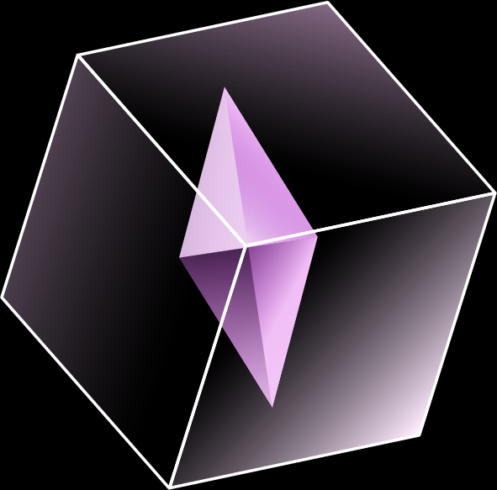
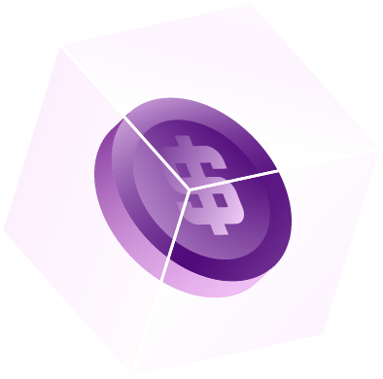
A Scalable Framework for Game Transformation and Metaverse Financing
FITE4801 Project
Wong On Bond, Jacky
BASc(FinTech)
UID 3035687479
jacky417@connect.hku.hk
April 2024

Slide 2
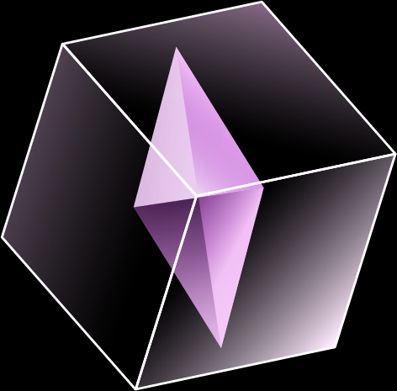
Today’s agenda
Background and motivation
Methodology
Result and implementation
Conclusion

Slide 3
Background and motivation | Methodology | Result and implementation | Conclusion
Background and motivation:
A quick recap from the interim presentation

Slide 4
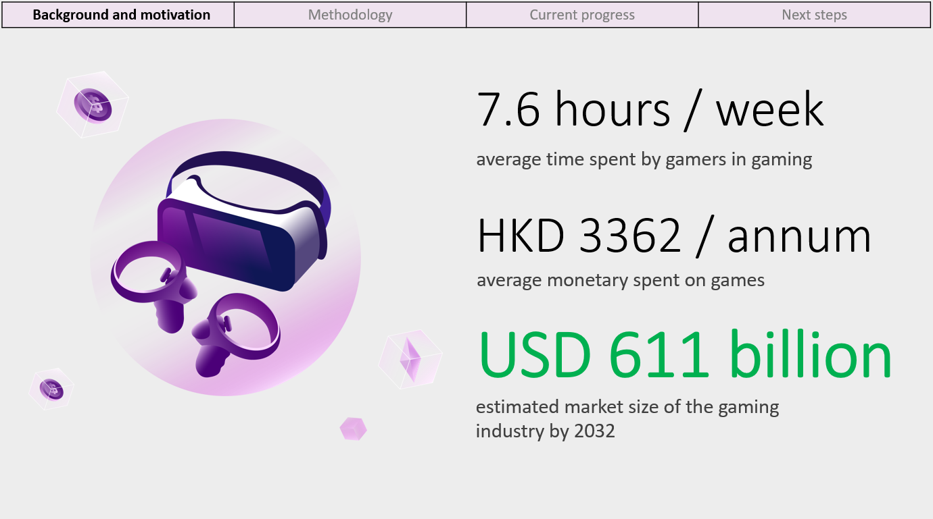
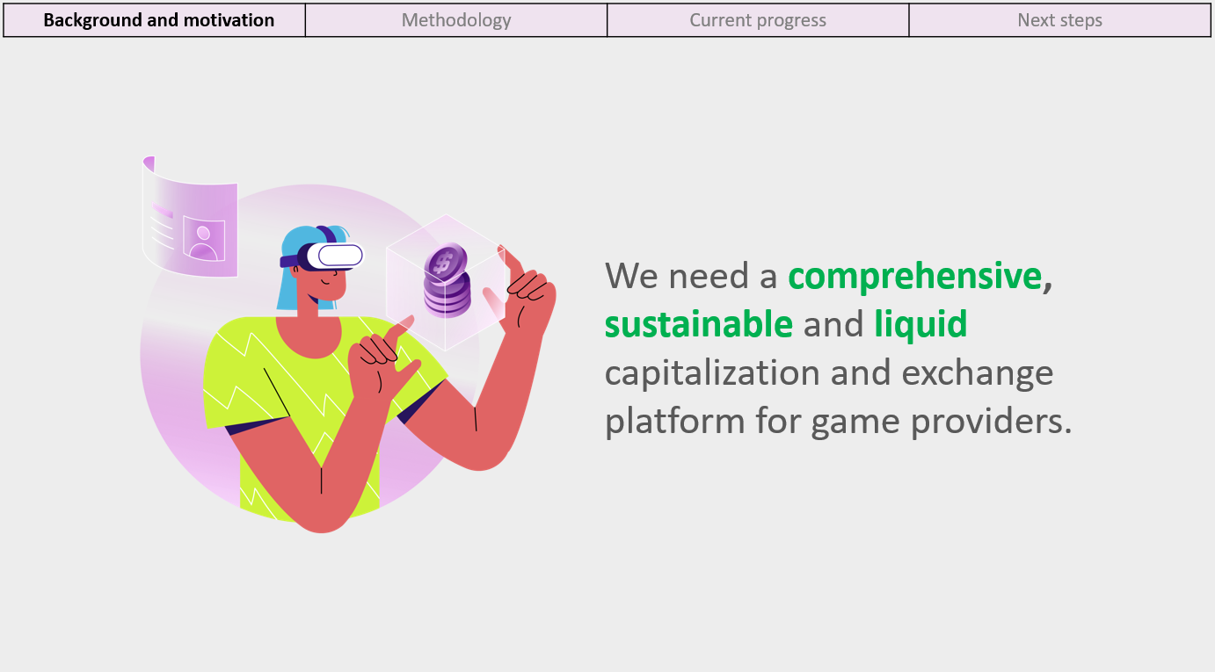
Background and motivation | Methodology | Result and implementation | Conclusion

Slide 5
Background and motivation | Methodology | Result and implementation | Conclusion
Methodology:
Revised ways for succeeding in GameFi

Slide 6
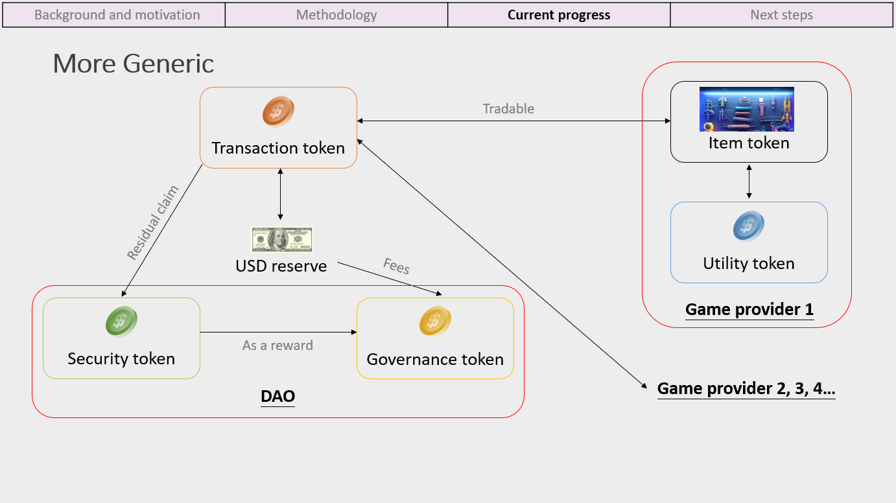
Background and motivation | Methodology | Result and implementation | Conclusion
Methodology 1: Deliver sustainable GameFi tokenomics

Slide 7
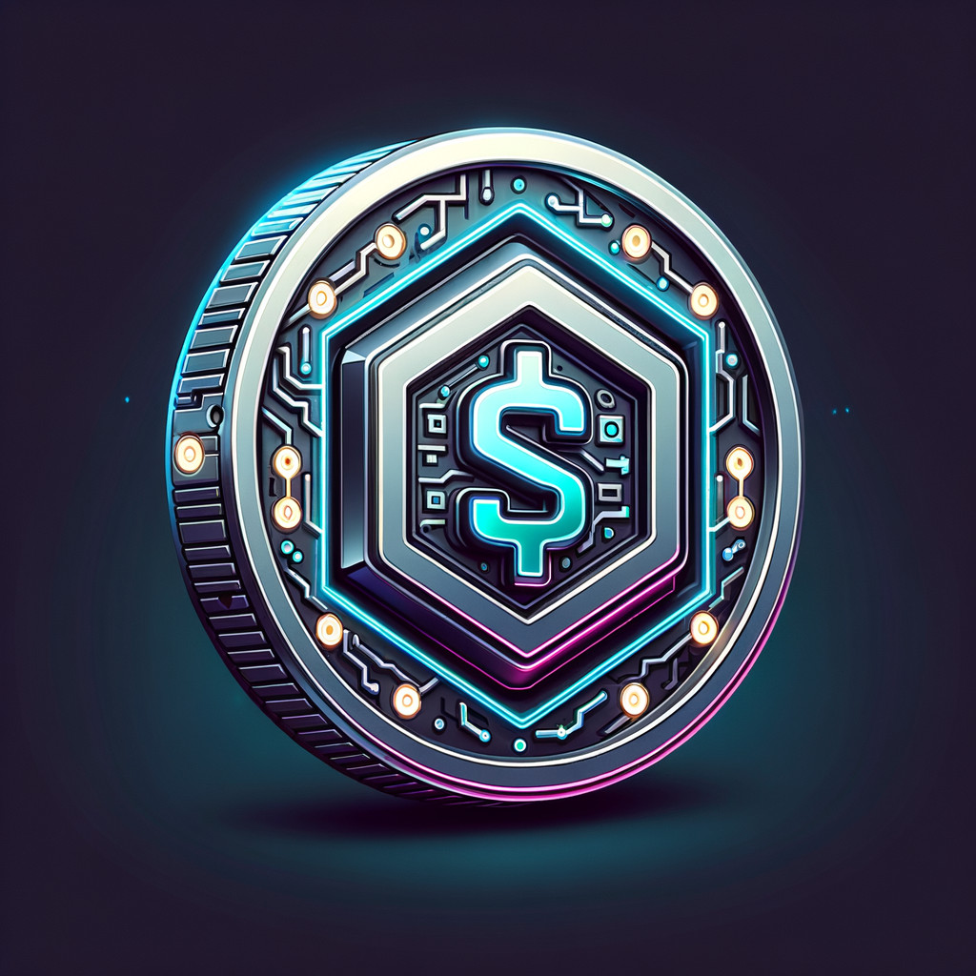
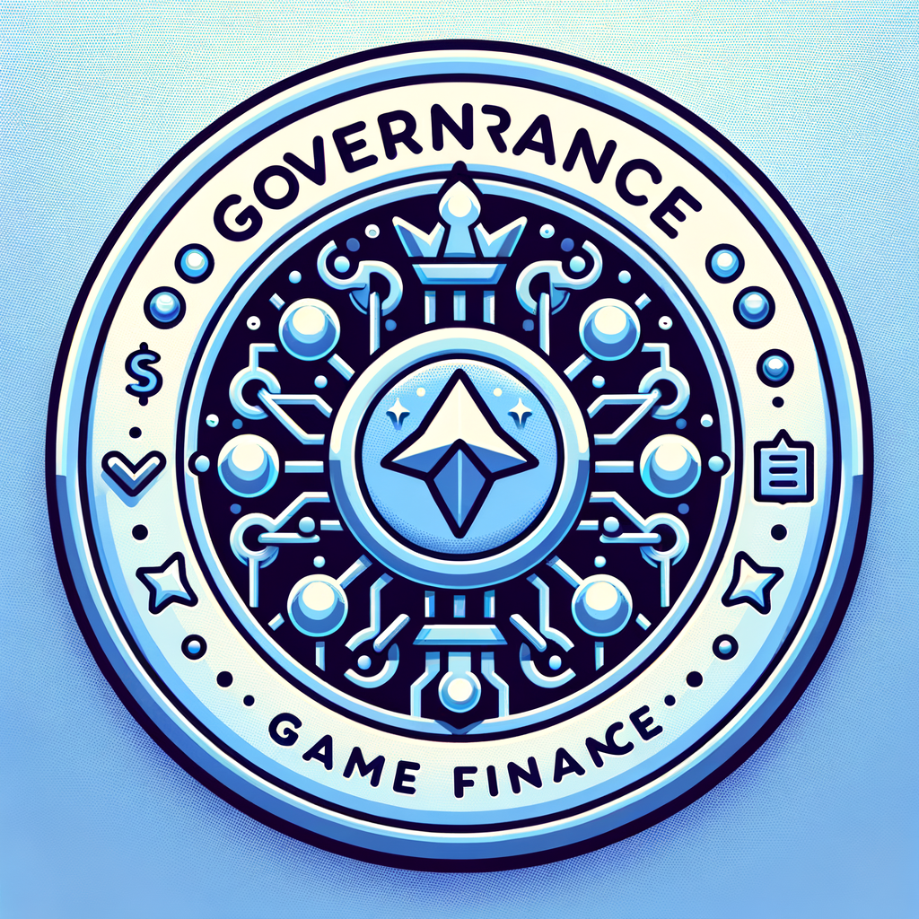
Background and motivation | Methodology | Result and implementation | Conclusion
Methodology 1: Deliver sustainable GameFi tokenomics
Dual token system
Currency token
Act as a currency in trading in-game assets
Mint as (algorithmically) stablecoin by using governance token to absorb volatility
Governance token
Represent the governing power of the DAO
Governance tokens of equivalent value to currency tokens collected in transactions as transaction fees are mint to the in-game asset issuers
Holders receive transaction fees as “dividend”

Slide 8
Background and motivation | Methodology | Result and implementation | Conclusion
Methodology 1: Deliver sustainable GameFi tokenomics
Dual token system (illustration)
In-game assets
(fungible/non-fungible)
Peer
Issue
Game providers
Developer
community
Investors
Trade
Mint governance tokens to
Collect transaction fees to
Treasury
Governance tokens
Currency tokens
Quadratic Voting DAO
Peer

Slide 9
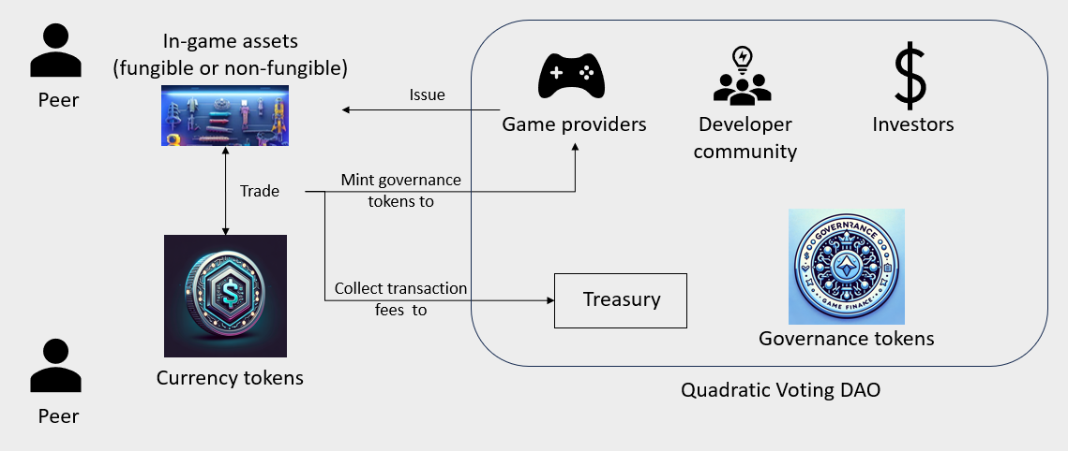
Background and motivation | Methodology | Result and implementation | Conclusion
Methodology 1: Deliver sustainable GameFi tokenomics
Dual token system
Peers can trade in-game assets freely.
DAO community are motivated from distributing collected transaction fees and quadratic voting scheme.
Game providers become major governors as time passes.

Slide 10
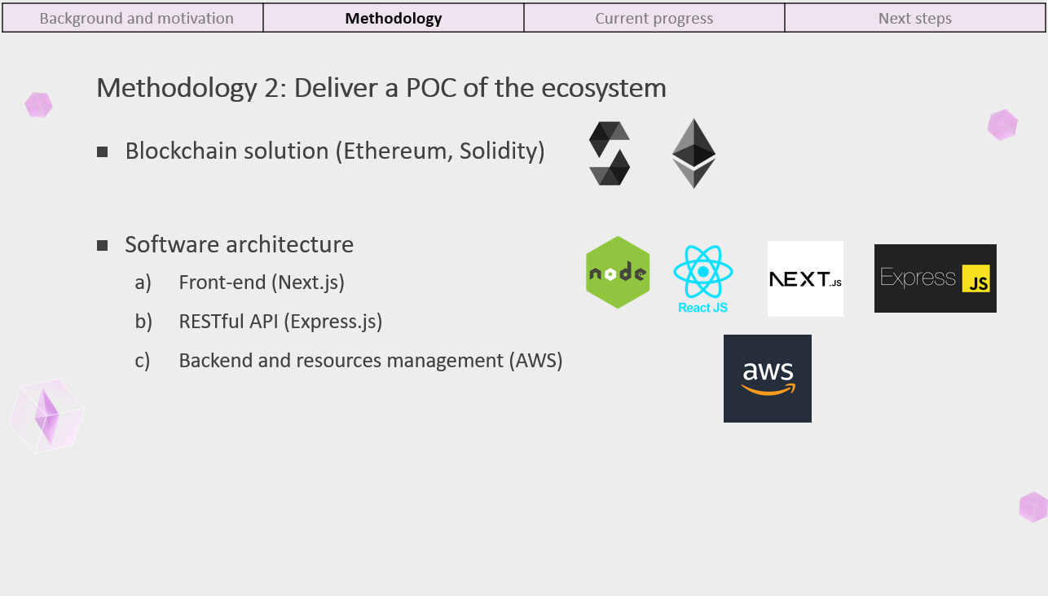
Background and motivation | Methodology | Result and implementation | Conclusion
Methodology 2: Deliver a POC of the ecosystem
Instead of the Ethereum and Solidity ecosystem, this project delivers the POC with the Solana frameworks.
Approx. 29,171 transactions per second
Average transaction gas fee at $0.003 to $0.005
Follows SPL-Token standard
15-45 transactions per second
Average transaction gas fee at approx. $1

Slide 11
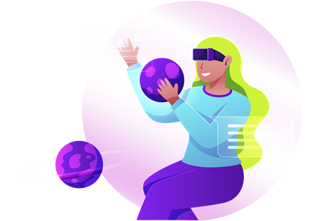
Background and motivation | Methodology | Result and Implementation | Conclusion
Result and Implementation:
The current solution

Slide 12
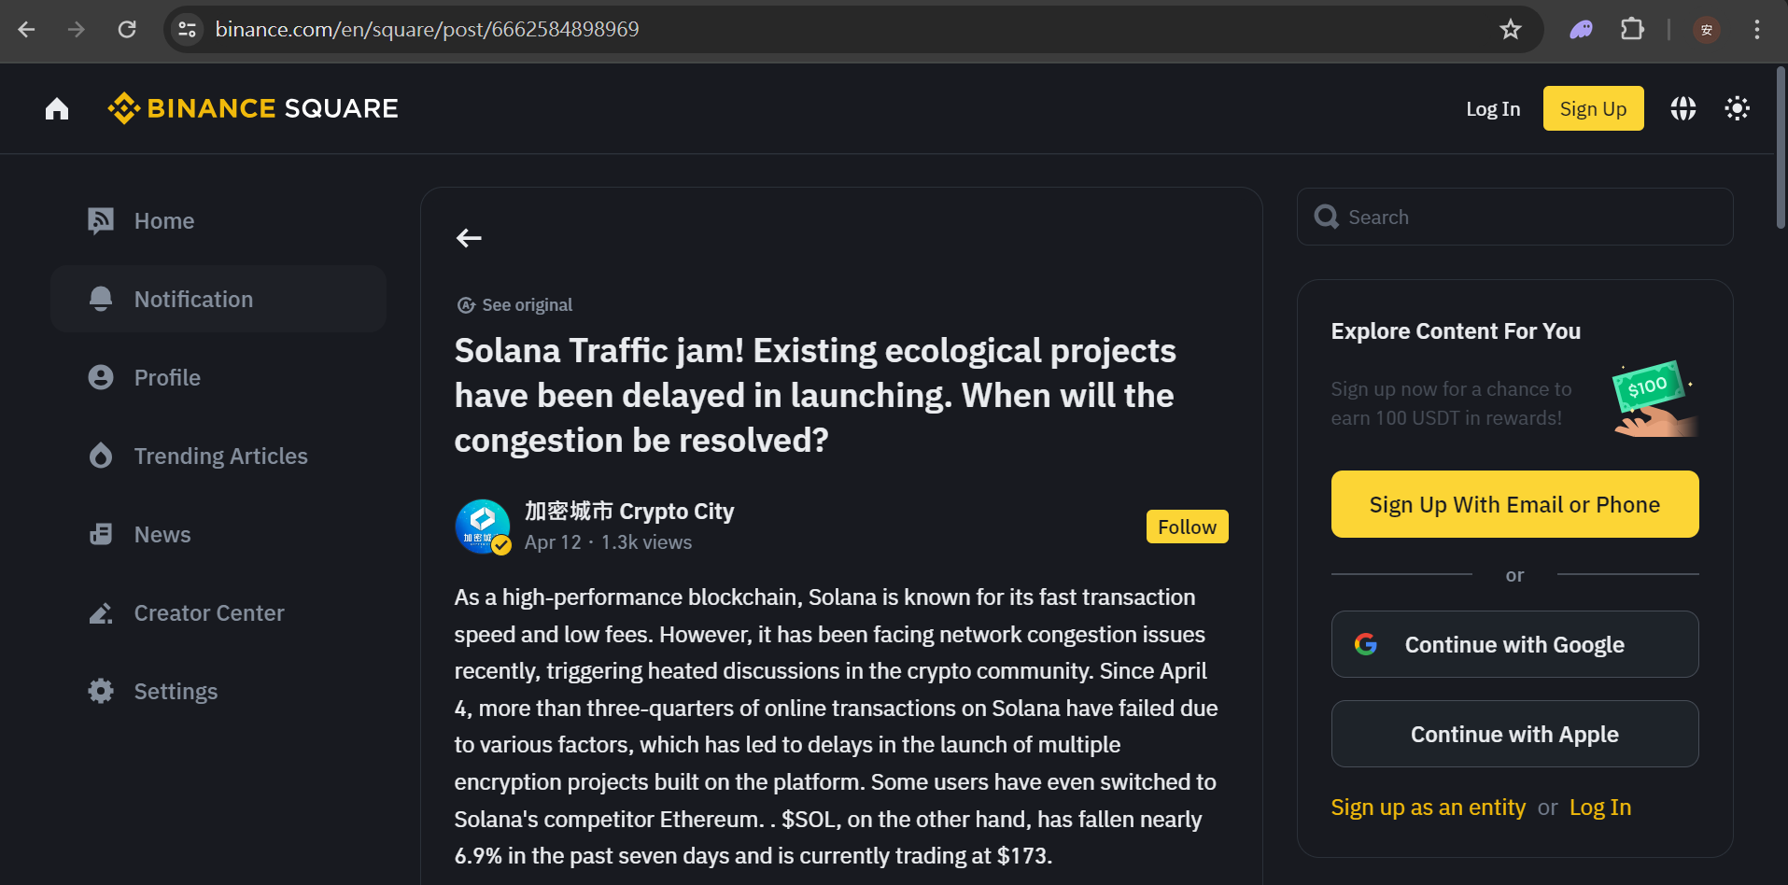
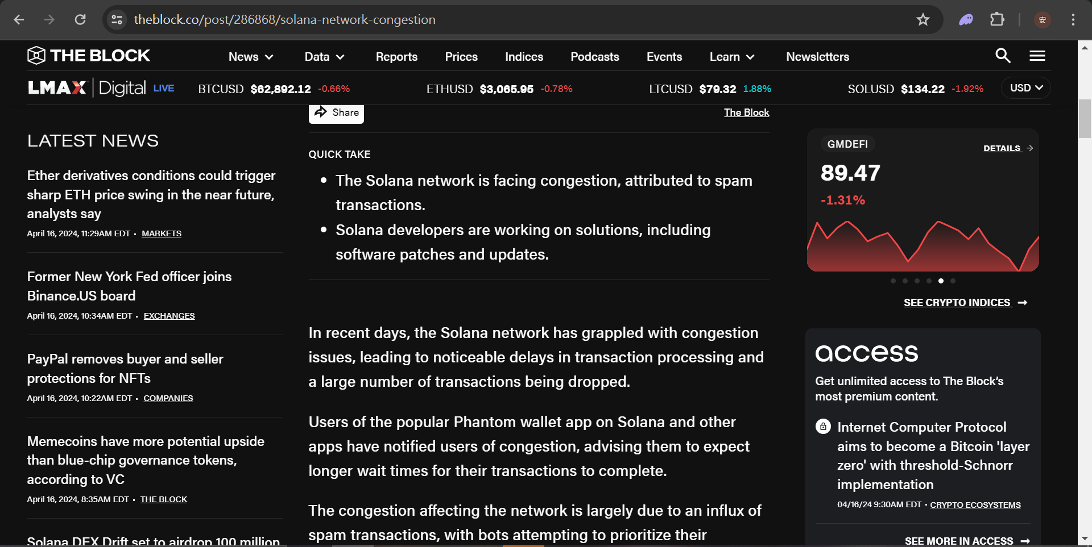
Background and motivation | Methodology | Result and Implementation | Conclusion
Some bad news first…
The scope of this project will now therefore focus on Solana Devnet implementation first. :(

Slide 13
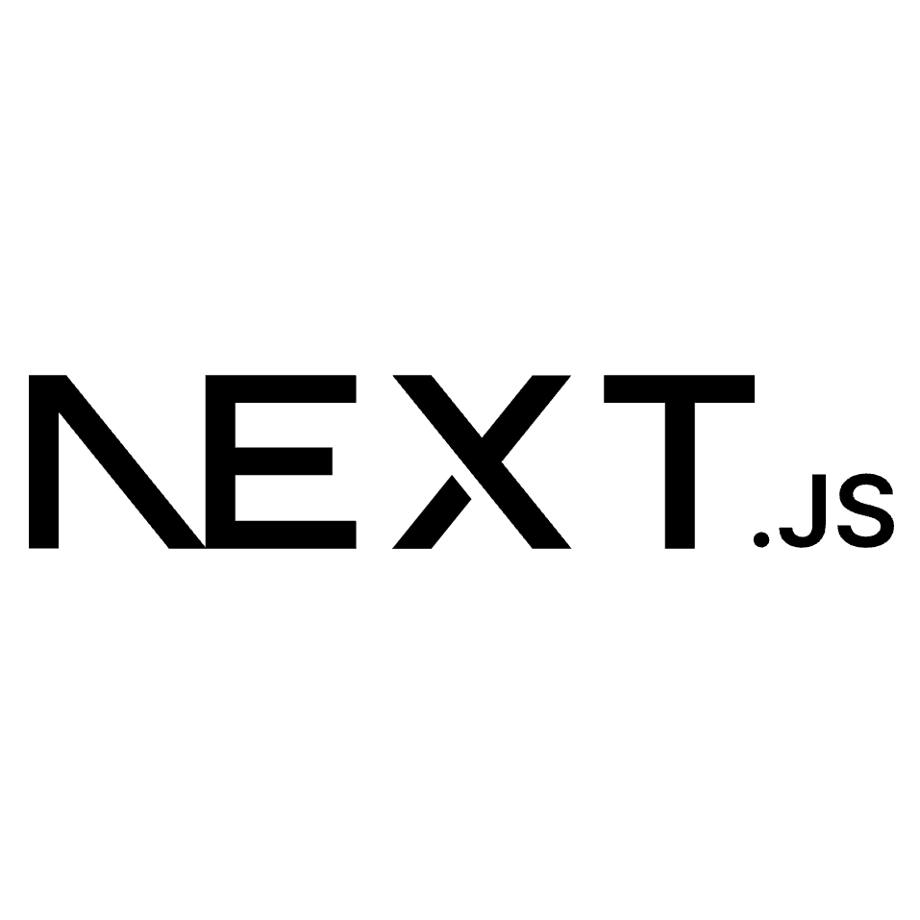
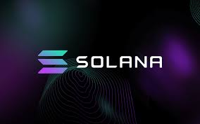
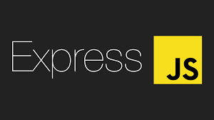
Background and motivation | Methodology | Result and Implementation | Conclusion
Implementation of the architecture
Peer
Front-end
Call Solana programs
Game providers
Devnet
Developer
community
Send instructions
API

Slide 14
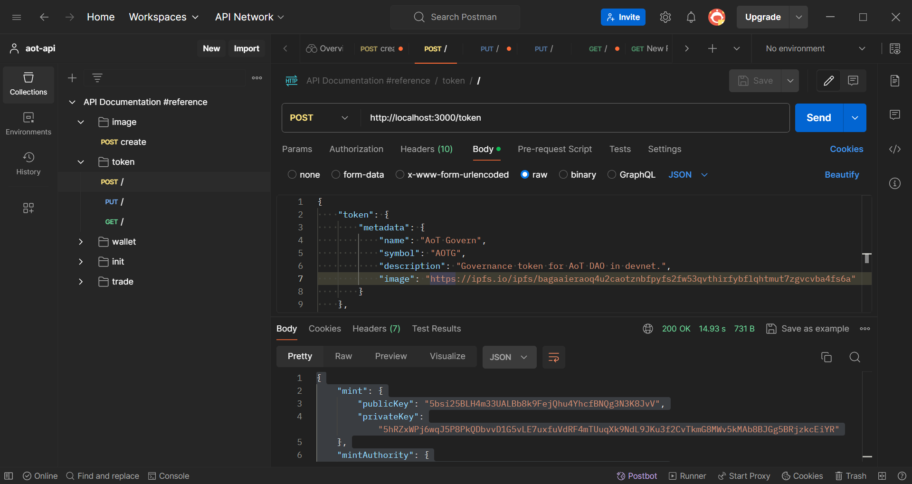
Background and motivation | Methodology | Result and Implementation | Conclusion
Implementation of the architecture (example)
HTTP request
Game providers
API

Slide 15
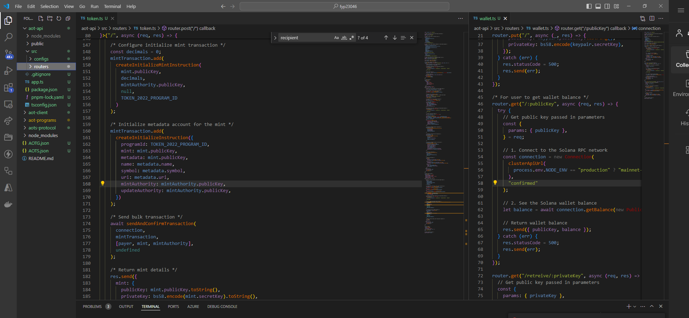
Background and motivation | Methodology | Result and Implementation | Conclusion
Implementation of the architecture (example)
Call Solana programs
API
Devnet

Slide 16
Background and motivation | Methodology | Result and implementation | Conclusion
Implementation of the architecture
Currency token
Created with a transfer hook, a Solana program that collects transaction fee to DAO treasury account and mint new governance tokens.
Governance token
Created similarly with the previous example.

Slide 17
Background and motivation | Methodology | Result and implementation | Conclusion
Implementation of the architecture
Currency token
Governance token

Slide 18
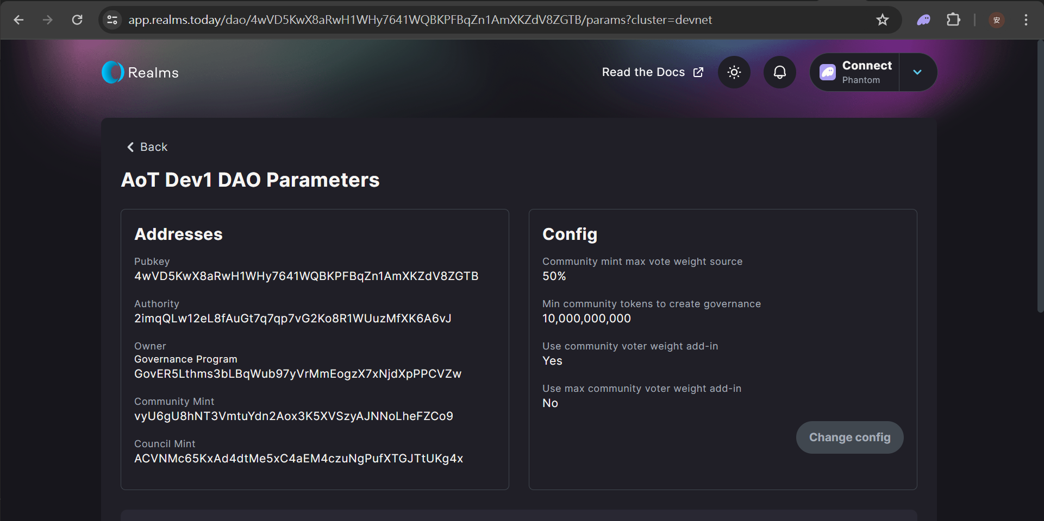
Background and motivation | Methodology | Result and implementation | Conclusion
Implementation of the architecture

Slide 19
Background and motivation | Methodology | Result and Implementation | Conclusion
Conclusion:
Next steps of the journey

Slide 20
Background and motivation | Methodology | Result and Implementation | Conclusion
This project has…
Launched the minimum dual token ecosystem
Deployed user interface and API POC on Solana Devnet
There is still plenty of possible enhancements!
Protocol for the currency token
Initial token allocation (e.g. minting backed by 1-to-1 reserve)
Switch to algorithmic stablecoin
Include non-fungible tokens
Liquidation pool for token swapping
so on…

Slide 21
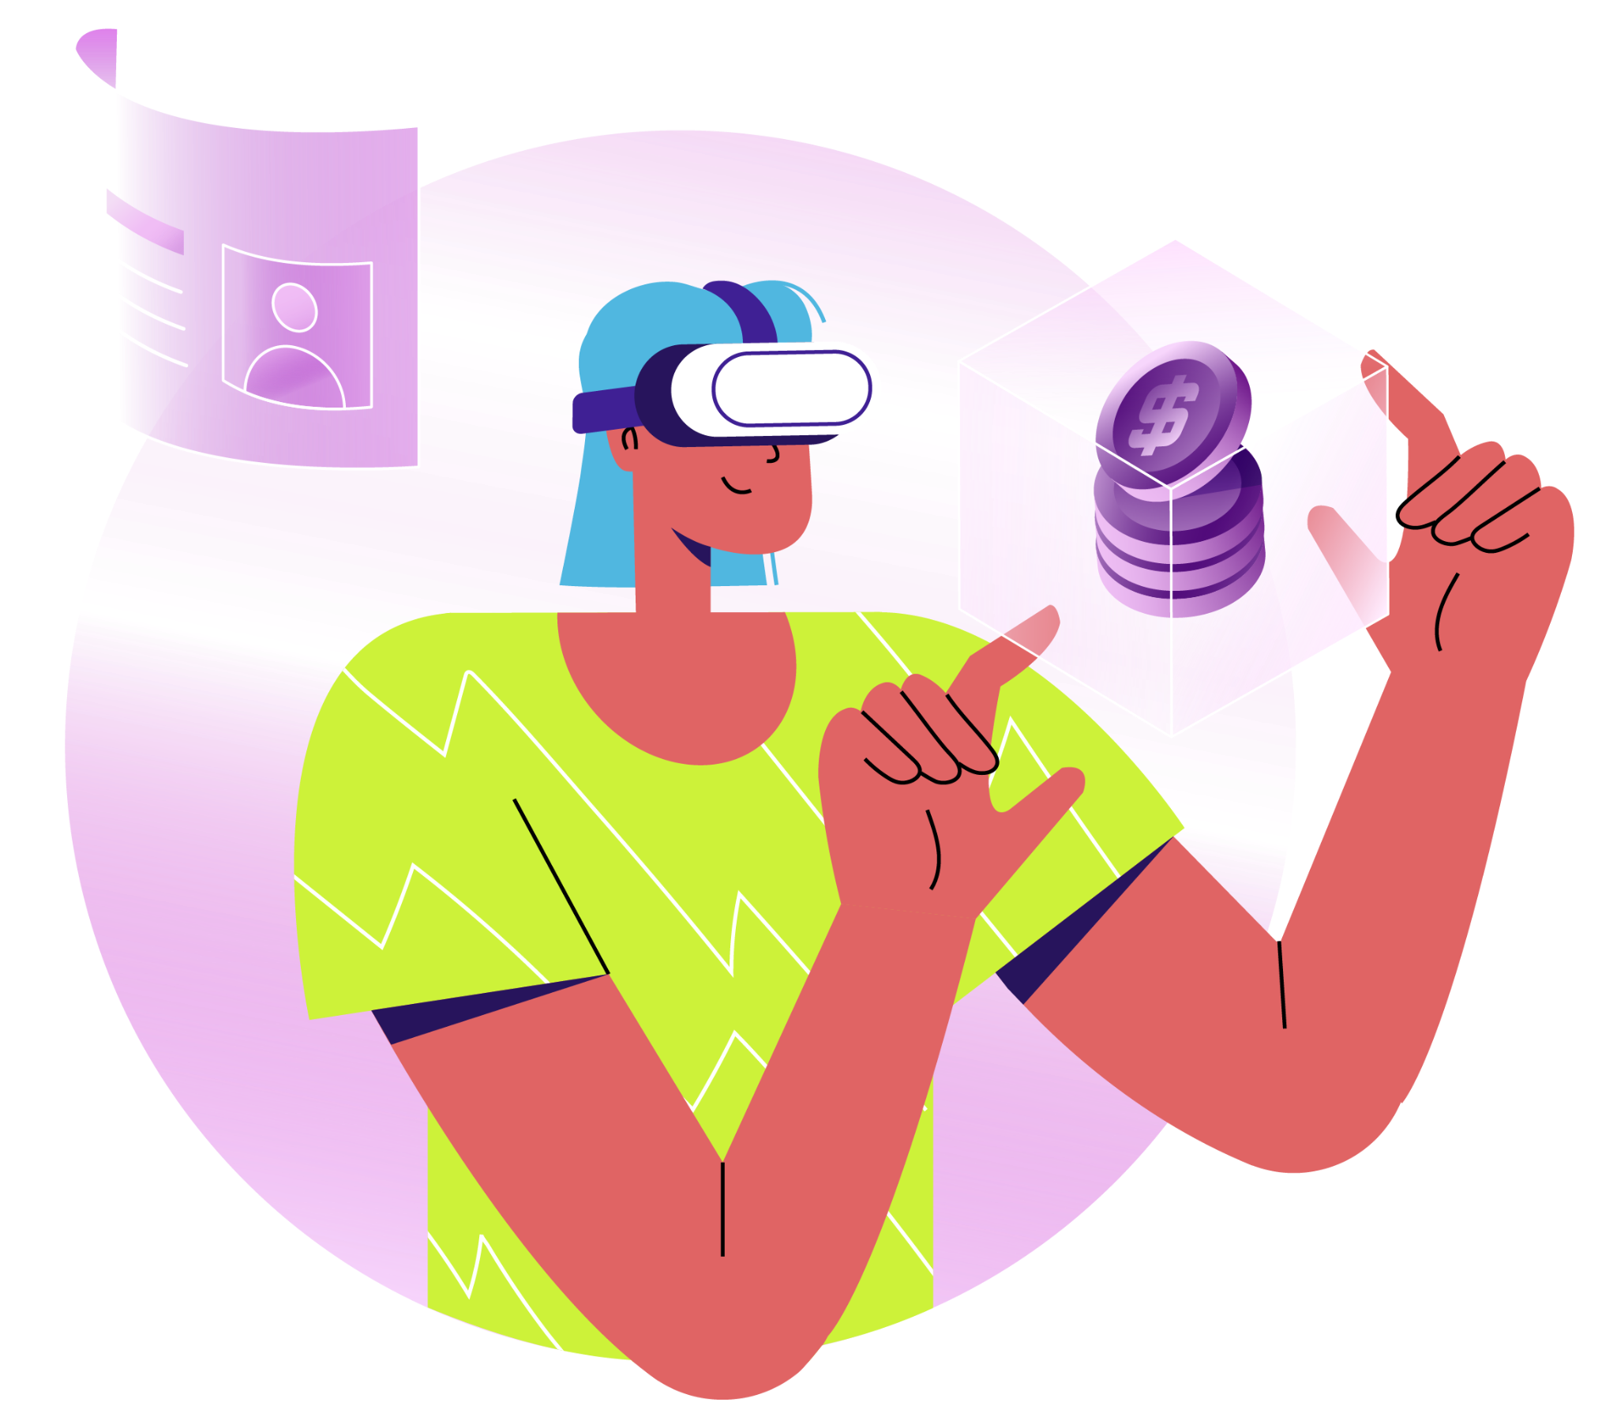
Q&A Session

