Slide 1



HKID OAuth Provider
CAES9542
Final Presentation
Harry Chiew Lik Seng (3035767487)

Slide 2
Overview
01 Background
02 Objectives
03 OAuth 2.0
04 Deliverables
05 User Flow Diagram
06 Challenges Faced
07 Future Improvements

Slide 3


Background
Inefficient real-name verification process
  Photo camera capture
  Retake if bad photo quality
  Repeated procedure for every other client application

Slide 4



Objectives
Simplify the online
identity verification process
Deliver a developer-friendly authentication tool

Slide 5

OAuth 2.0 Protocol
  Widely deployed authorization framework
  Grants limited access to resources to third-party applications
  No credentials exposure

Slide 6



Deliverables
HKID Frontend Application
HKID Backend
OAuth Server
HKLIB Client Application

Slide 7
HKID Frontend Application
HKID Authorization Grant Request Page
HKID Login Page

Slide 8

Login Page
Figure 1: Screencap of HKID Login Page

Slide 9
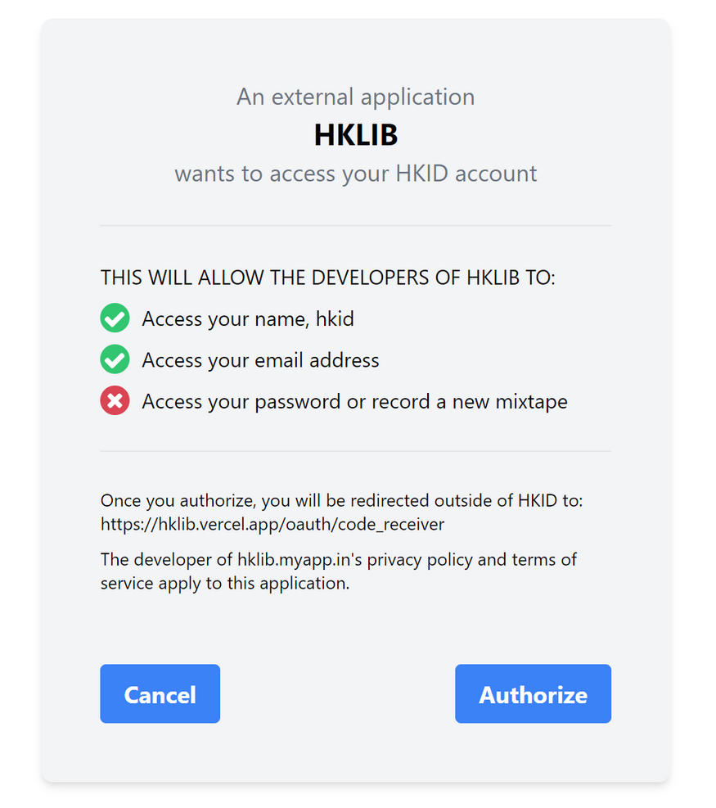
Authorization Grant Request Page
Figure 2: Screencap of HKID Authorization Grant Request Page

Slide 10

Frontend Tech Stack
Rapid development & high performance
Component-based architecture
REACT.JS
TAILWIND CSS

Slide 11
Backend Server
  Acts as an OAuth Server that provides REST APIs for frontend to call upon
  Two main API endpoints: Authorization Endpoint & Token Endpoint
  Authorization Endpoint returns Authorization Code & Token Endpoint returns Access Token

Slide 12
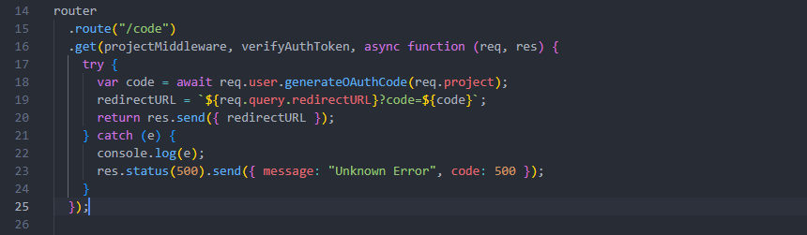
Authorization Endpoint
Figure 3: Code snippet of Authorization code API endpoint

Slide 13
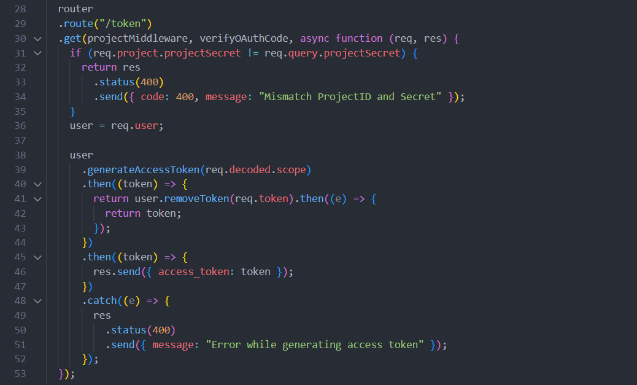
Token Endpoint
Figure 4: Code snippet of Access Token API endpoint

Slide 14
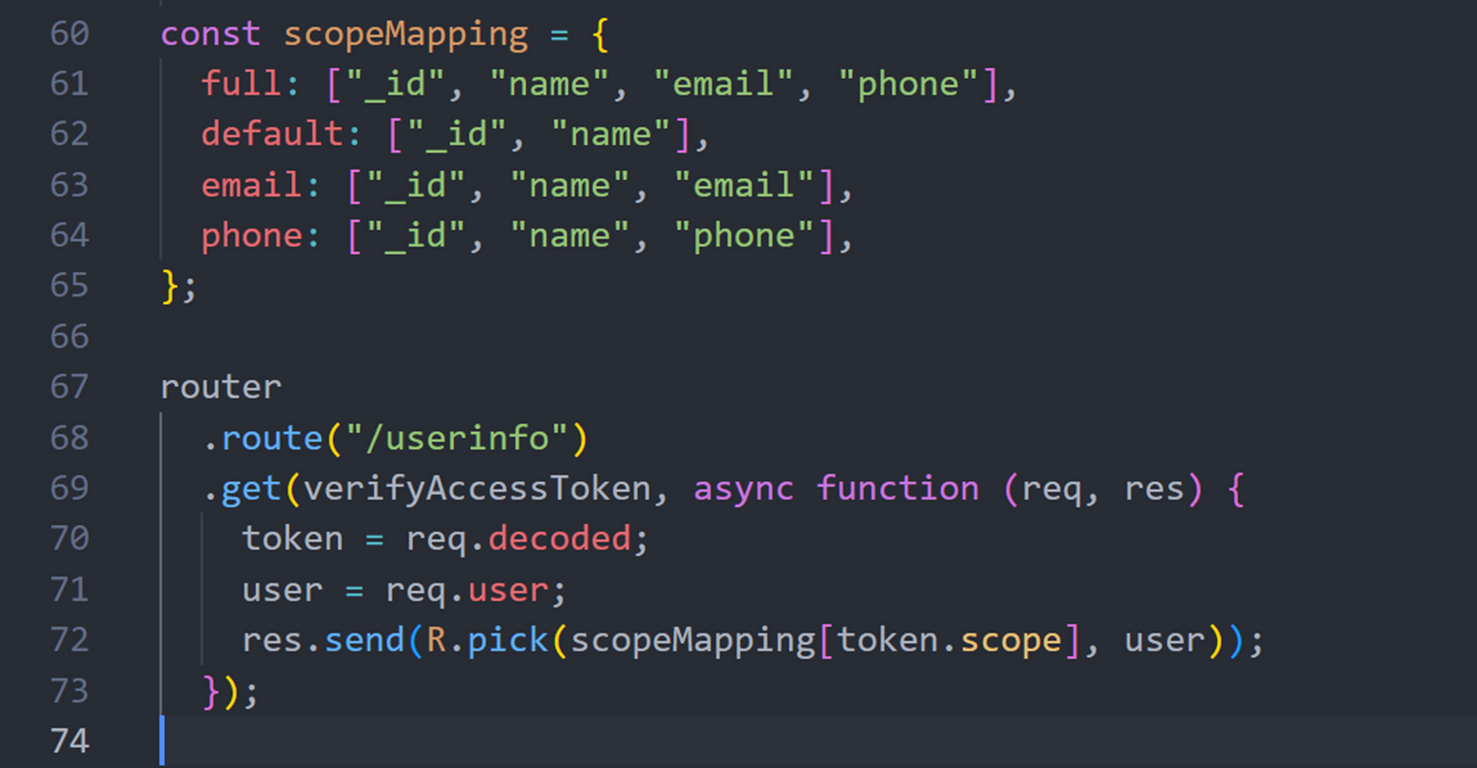
User Info Endpoint
Figure 5: Code snippet of User Info API endpoint

Slide 15






Backend Tech Stack
Non-blocking and event-driven architecture
NPM
(Node Package Manager)
Rich JavaScript Ecosystem
Express framework

Slide 16
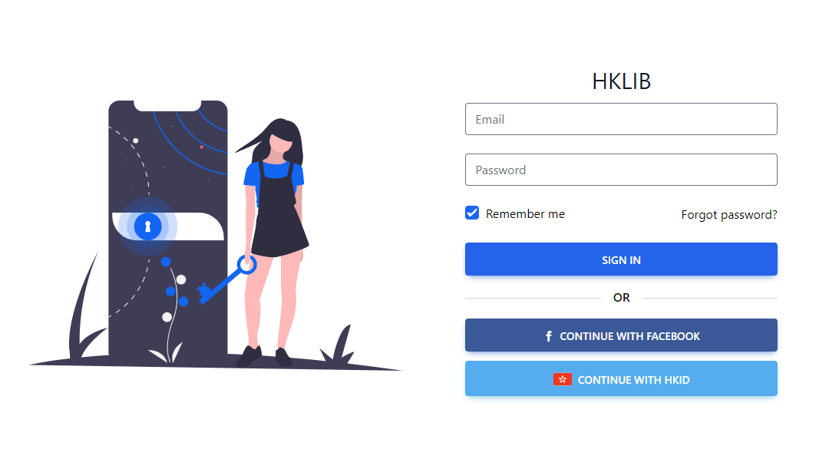
HKLIB Client Application
Figure 6: Screencap of HKLIB Login Page

Slide 17
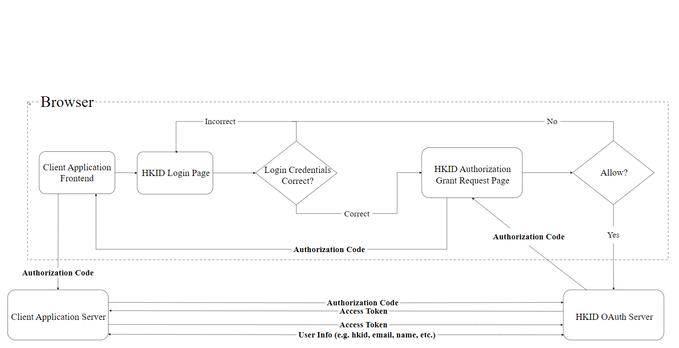
User Flow Diagram
Figure 7: User Flow Diagram of HKID OAuth

Slide 18
Challenges Faced

Slide 19
Authorization Code Injection
  Happens when attackers sniff the returned Authorization Code and
  Client secret cannot be safely guarded by the client application
  Solution: Proof Key for Code Exchange (PKCE)

Slide 20
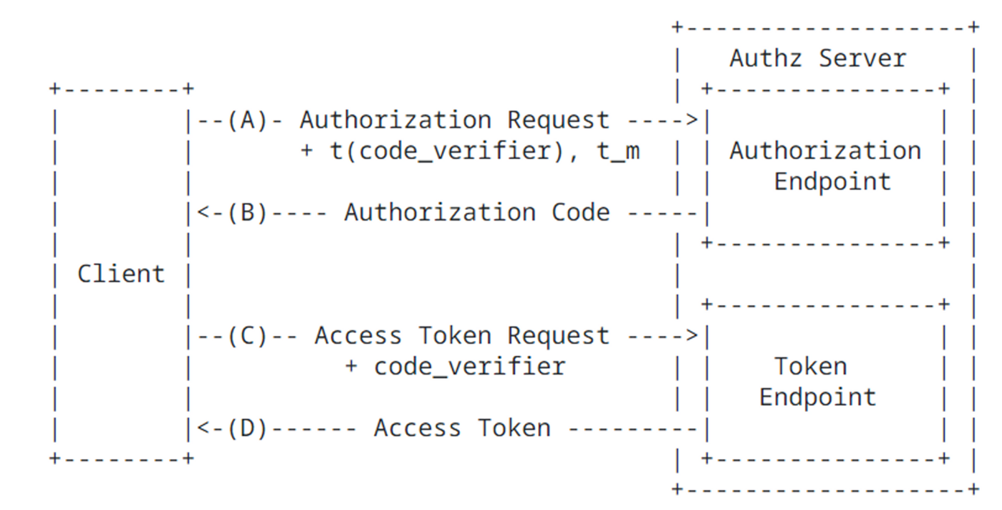
Proof Key for Code Exchange
Figure 2: OAuth Workflow with PKCE

Slide 21
Future Improvements

Slide 22
User authentication method
  Weak and susceptible to online phishing attacks
  Losing one set of login credentials could cost multiple account losses
  Replace user authentication method with passkeys

Slide 23
Passkeys
  A type of passwordless authentication that is based on public-key cryptography
  Stored locally on user’s device
  Resistant to online attacks like phishing

Slide 24

Conclusion
  Deliver a secure and convenient OAuth provider
  Utilizing bleeding edge technology frameworks
  Shipped to production

Slide 25
Thank
You
Q&A session

Slide 26
References
[1] “Example React Login Page”, https://q2eyzl.csb.app/#
[2] “Digital Around the World”, https://datareportal.com/global-digital-overview
[2] J. Lee, C. Liu, “Real-Name Registration Rules and the Fading Digital Anonymity in China,” Washington International Law Journal, Vol 25, No. 1, 2016. https://digitalcommons.law.uw.edu/cgi/viewcontent.cgi?article=1717&context=wilj
[3] L. John, “Identifying the Problem: Korea’s Initial Experience with Mandatory Real Name Verification on Internet Portals,” Journal of Korean Law, Vol. 9, 83-108, December 2009. https://sspace.snu.ac.kr/bitstream/10371/85159/1/4.%20Identifying%20the%20Problem%20Korea%E2%80%99s%2 0Initial%20Experience%20with%20Mandatory%20Real%20Name%20Verification%20on%20Internet%20P ortals.pdf
[4] D. Hardt, “RFC 6749 The OAuth 2.0 Authorization Framework,” Internet Engineering Task Force (IETF), October. https://datatracker.ietf.org/doc/html/rfc6749
[5] N. Sakimura, J.Bradley, and N. Agarwal, “RFC 6749 The OAuth 2.0 Authorization Framework,” Internet Engineering Task Force (IETF), October. https://datatracker.ietf.org/doc/html/rfc7636
[6] T. Lodderstedt, M. McGloin, P. Hunt, “OAuth 2.0 Threat Model and Security Considerations”, RFC 6819, DOI 10.17487/RFC6819, January 2013, http://www.rfc-editor.org/info/rfc6819.

