Slide 1
OptiTrans
Real-Time Optimized Public Transportation Navigation App
Final Year Project by Bowen, Liuhao LI (3035825758)

Slide 2
Outline
01
02
03
04
05
06
Introduction
Methodology
Difficulties and Mitigation
Schedule and Status
Conclusion and Next Steps
References

Slide 3
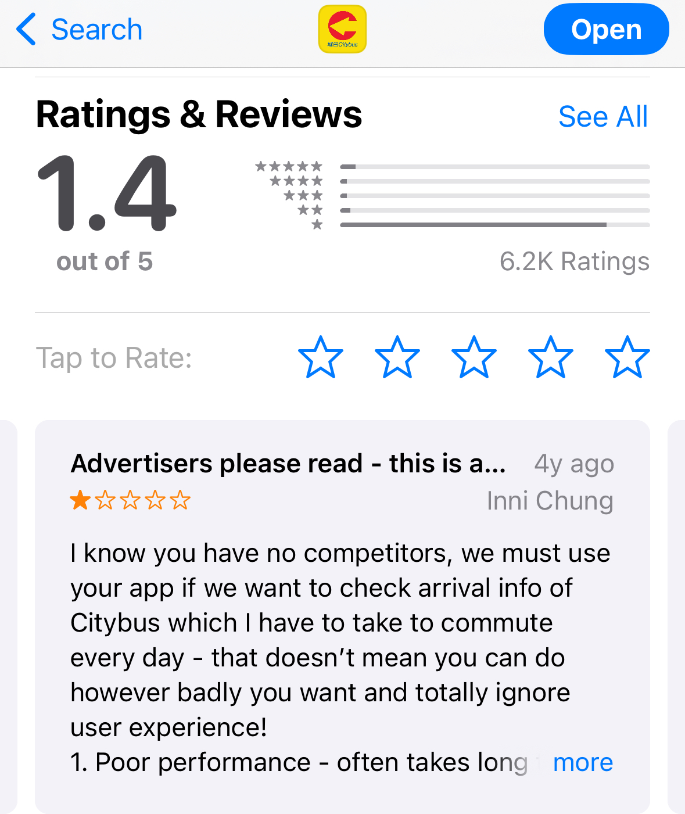
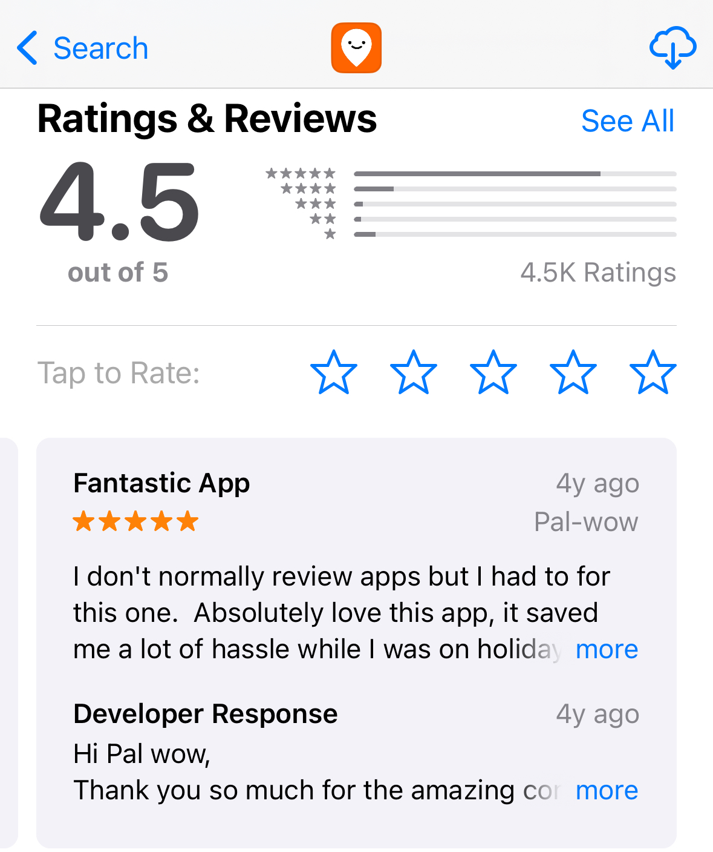
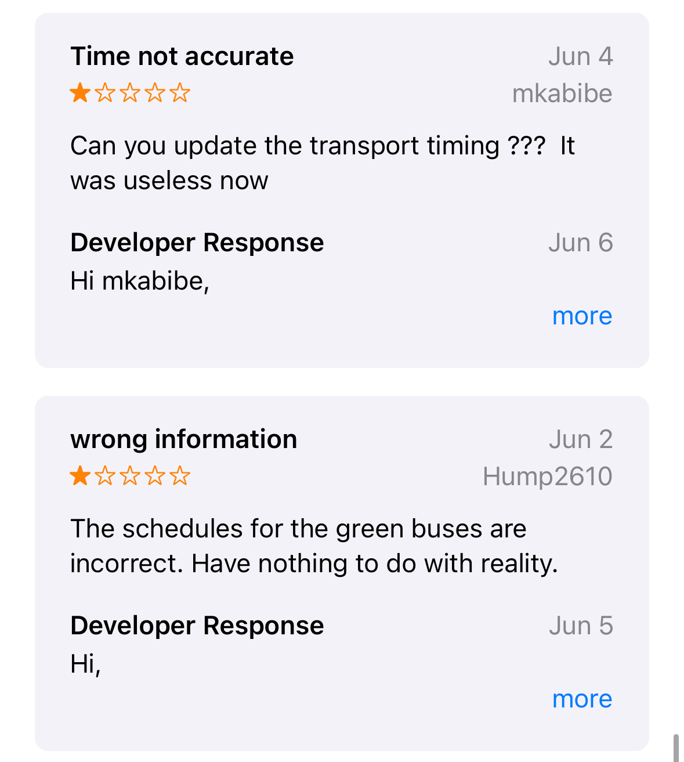
Introduction
Background: Importance of efficient public transportation in Hong Kong
Motivation: Addressing the limitations of existing transportation apps

Slide 4
Methodology
Data Aggregation
API Integration
Data Structure Design
Real-Time Data Processing
Data Processing Algorithms
Database Management

Slide 5
Methodology
Route Optimization
Algorithm Development
Current and Historical
Recalculation of Routes
Machine Learning
User Preferences
Mobile Application Development
Front-End Development
Back-End Development
Testing and Iteration
User Testing
Iterative Development

Slide 6
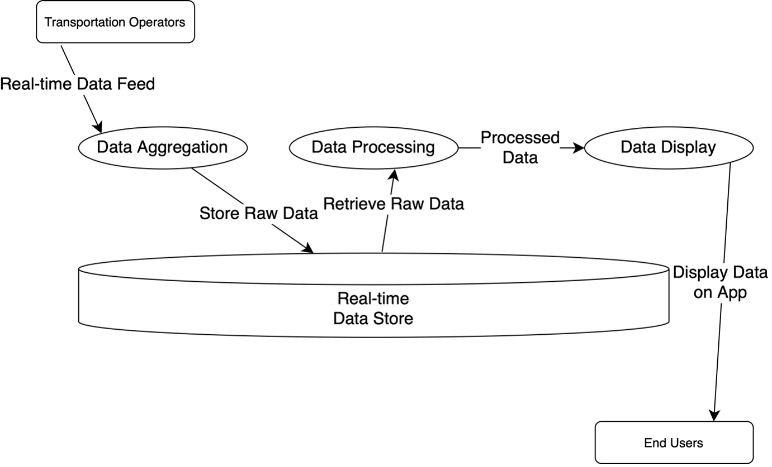
Preliminary Results
Data Aggregation: Integrated a vast array of transportation data; updates over 4500 data points per minute.
Real-Time Data Processing: Achieved a 10% reduction in processing time with custom algorithms.
Route Optimization: Incorporating real-time traffic and user preferences; 15% increase in efficiency in initial tests.
Continuous Improvement: Exceeding expectations and focusing on developing the front-end of OptiTrans.

Slide 7
Difficulty
Mitigation
Lack of academic resources and research to the Hong Kong public transport domain
Finding suitable APIs and datasets
Extensive research in related areas to find information that could be adapted to our project
Exhaustive study of their data formats and relevant policies
and

Slide 8
Difficulty
Mitigation
Variability in the formats of data provided by different APIs
Data Encoding
Diverse Naming Conventions
Distinct Approaches to Representing key information
Middleware Layer Development
Data Mapping and Normalization
Regular Data Format Reviews and Updates
and

Slide 9
Difficulty
Mitigation
Integrating and Utilizing Delay Information from APIs
Seamless Integration of This Data Into the App's Interface
High Volume of Incoming Data During Peak Usage Times
Real-Time Data Integration Framework
Data Synchronization and Updating Mechanisms
Load Testing and Performance Optimization
and

Slide 10
Difficulty
Mitigation
Iterative approach: conducting in-depth user testing to gather to refine thealgorithms continually
Integration of machine learning techniques to further enhance route suggestions
Crafting algorithms for real-time route suggestions while maintaining a user-friendly nterface requires a delicate balance.
and

Slide 11
Schedule and Status
Oct 20
Oct 1
Dec 1
Feb 15
Mar 15
Apr 15
Initiation
Data Aggregation
Literature Review
Find APIs & Datasets
API Connections
Data Structures
Data Processing
Route Optimization
Algorithms
Databases
Optimization Algorithms
Route Customization
App Development
Iteration & Documentation
Develop Front End
Implement Back End
User Testing

Slide 12
Conclusion and Next Steps
Revolutionize
public transportation experience in Hong Kong.
Finish Data Processing, proceed to Route Optimization and Front End.
Deploy a reliable, accurate, and user-friendly app for commuters.
Summary
Next Steps
Final Goal

Slide 13
References
Apple Inc. (n.d.). App Store [Hong Kong]. Retrieved October 24, 2023, from https://www.apple.com/hk/en/app-store/
Chen, B. Y., Lam, W. H. K., & Sumalee, A. (2012). Vulnerability analysis for large-scale and congested road networks with demand uncertainty. Transportation Research Part A: Policy and Practice, 46(3), 501-516.
Lo, H. K., & Szeto, W. Y. (2009). Time-dependent transport network design under cost-recovery. Transportation Research Part B: Methodological, Elsevier, 43(1), 142-158, January.
Ferris, B., Watkins, K., & Borning, A. (2010). OneBusAway: Results from providing real-time arrival information for public transit. In Proceedings of the SIGCHI Conference on Human Factors in Computing Systems (pp. 1807-1816).
Cats, O., & Loutos, G. (2016). Real-time bus arrival information system: An empirical evaluation. Journal of Intelligent Transportation Systems, 20(2), 138-151.
Brakewood, C., Macfarlane, G. S., & Watkins, K. (2015). The impact of real-time information on bus ridership in New York City. Transportation Research Part C: Emerging Technologies, 53, 59-75.

Slide 14
Thanks!
Do you have any question?
OptiTrans
Final Year Project Presentation
Bowen, Liuhao LI (UID: 3035825758)
Jan 15, 2024

